Slide 1
Vet Science CDE
Breed Species ID
Poultry

Slide 2
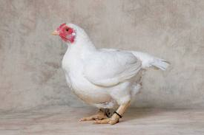
Cornish Chicken

Slide 3
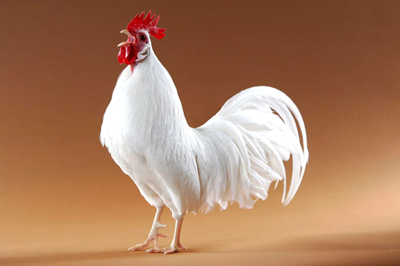
Leghorn Chicken
May also be red.

Slide 4
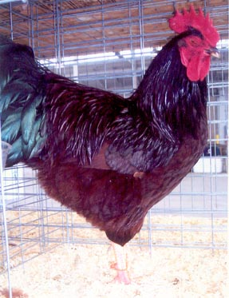
Rhode Island Red

Slide 5
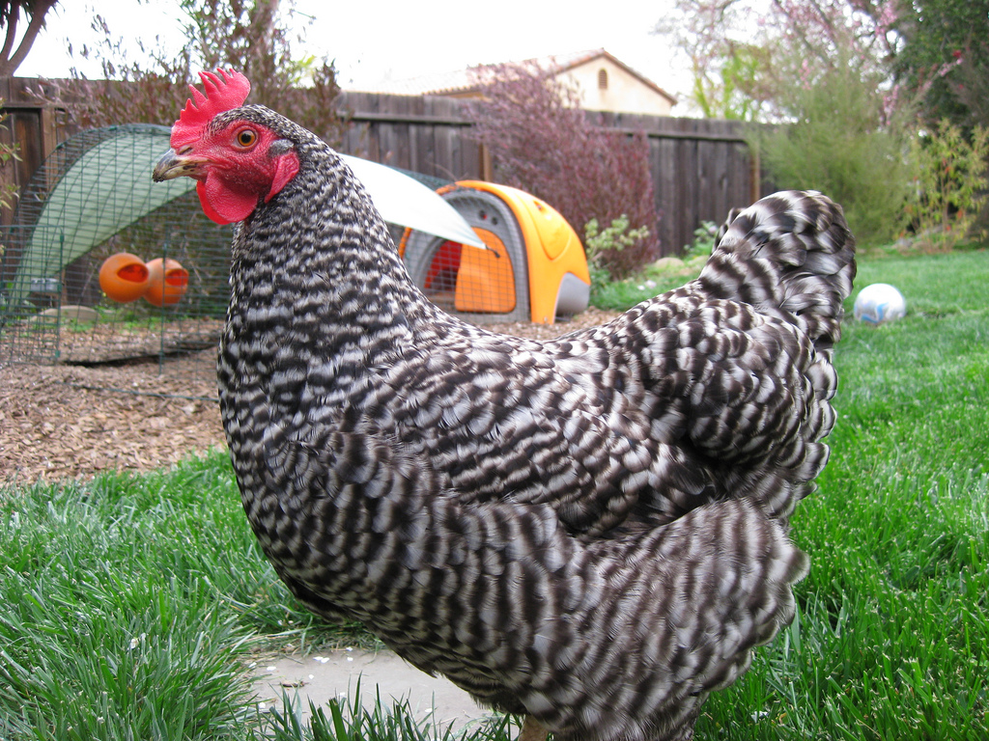
Plymouth Rock

Slide 6
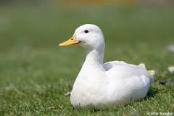
Duck

Slide 7
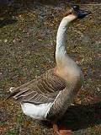
Geese

Slide 8
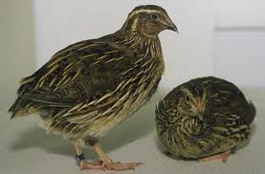
Quail

Slide 9
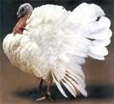
Turkey

