Slide 1
Vet Science CDE
Swine Breed ID

Slide 2
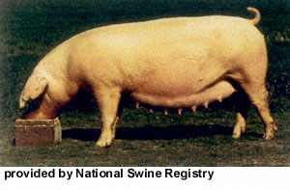
American Landrace

Slide 3
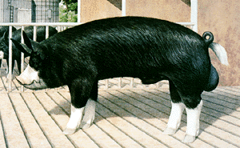
Berkshire

Slide 4
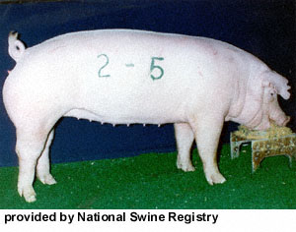
Chester White

Slide 5
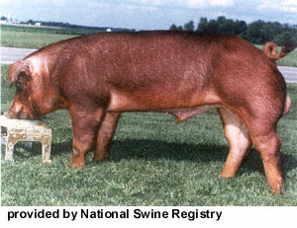
Duroc

Slide 6
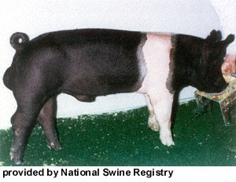
Hampshire

