Slide 1
Vet Science CDE
Dairy & Beef Cattle ID

Slide 2
Dairy Cattle

Slide 3
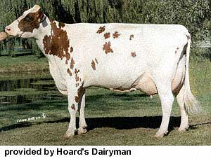
Ayrshire

Slide 4
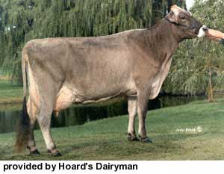
Brown Swiss

Slide 5
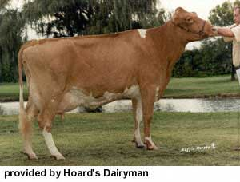
Guernsey

Slide 6
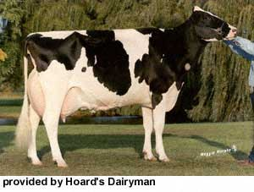
Holstein

Slide 7
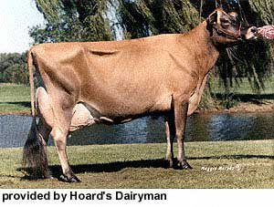
Jersey

Slide 8
Beef Cattle

Slide 9
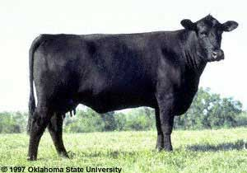
Angus

Slide 10
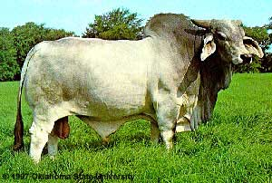
Brahman

Slide 11
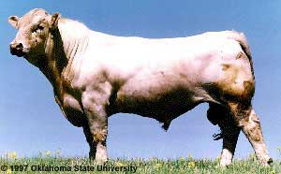
Charolais

Slide 12
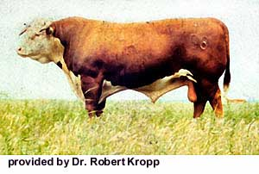
Hereford

Slide 13
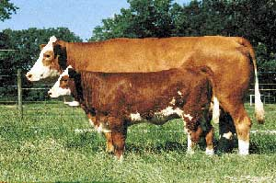
Simmental

Slide 14
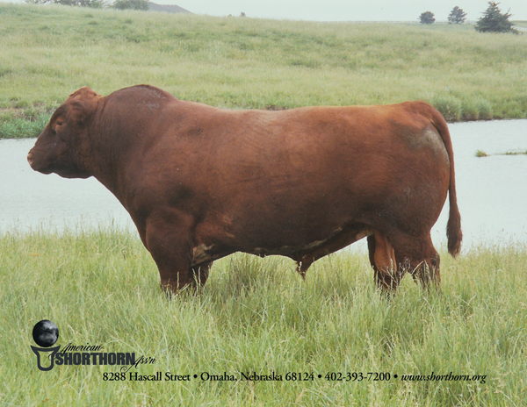
Shorthorn

