Slide 1
Floriculture

Slide 2
Plants

Slide 3
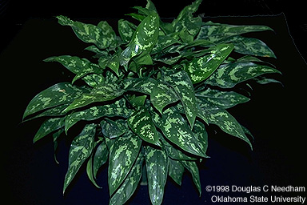
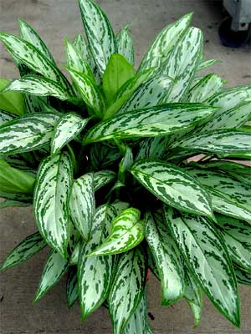
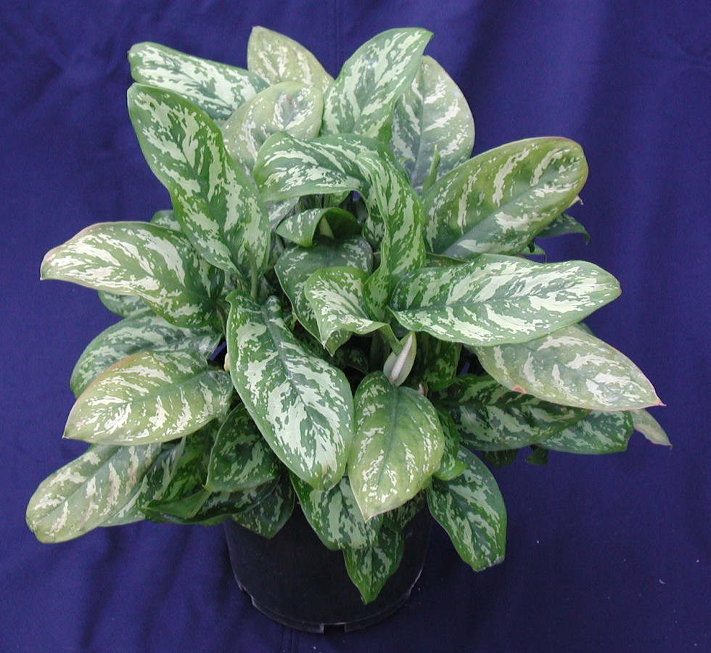
Aglaonema commutatum cv. Aglaonema

Slide 4
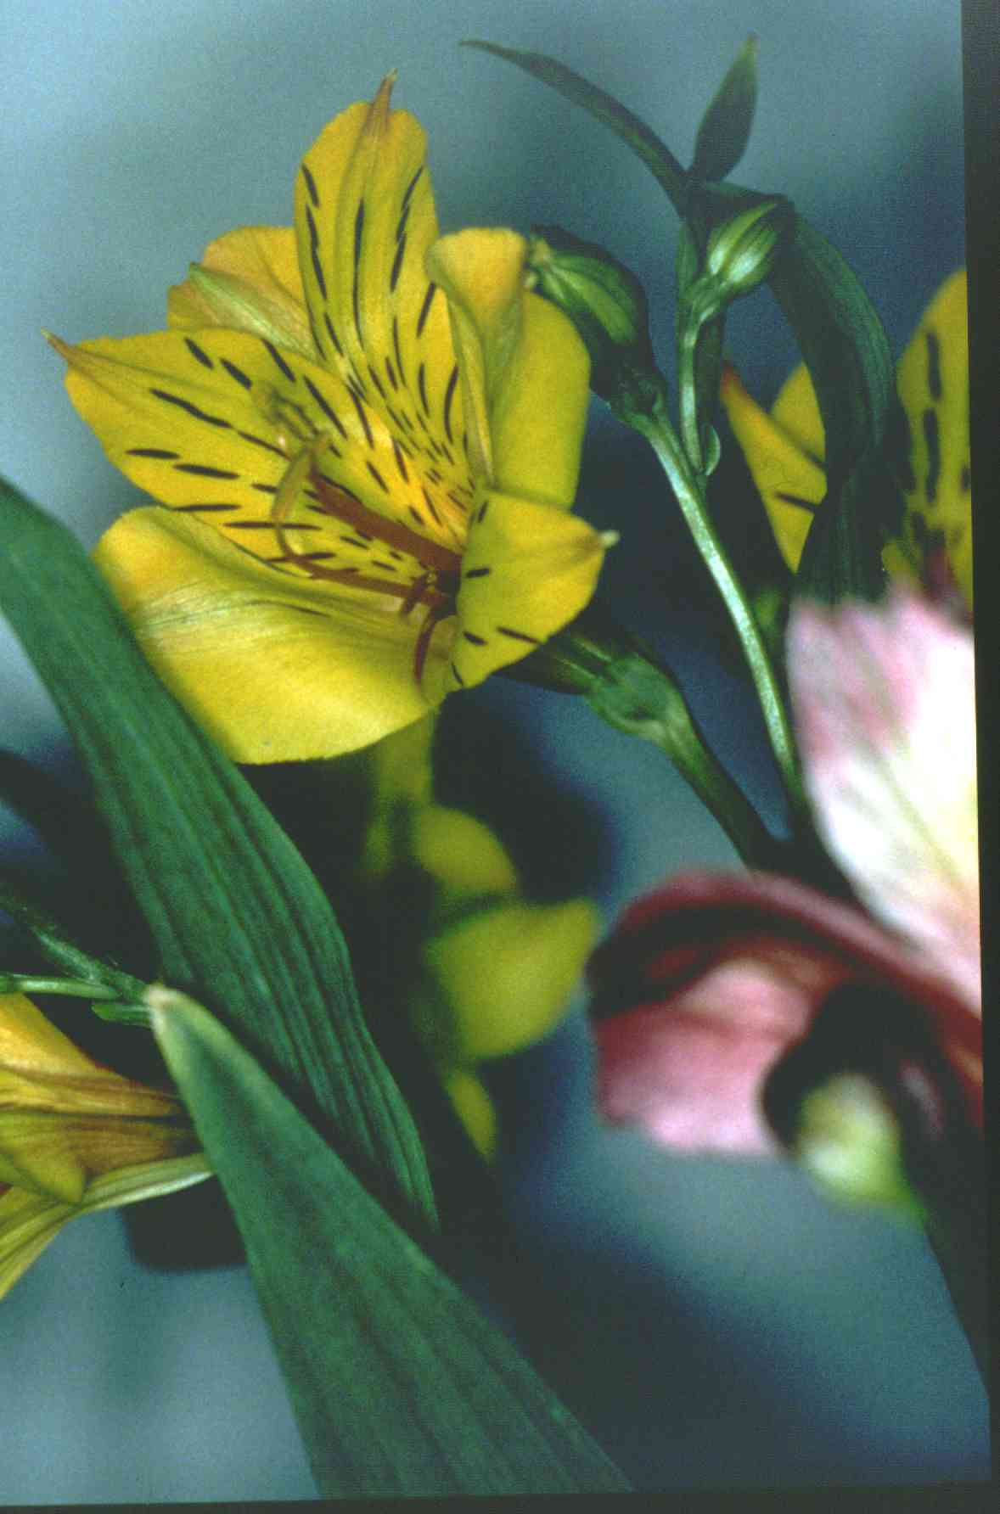
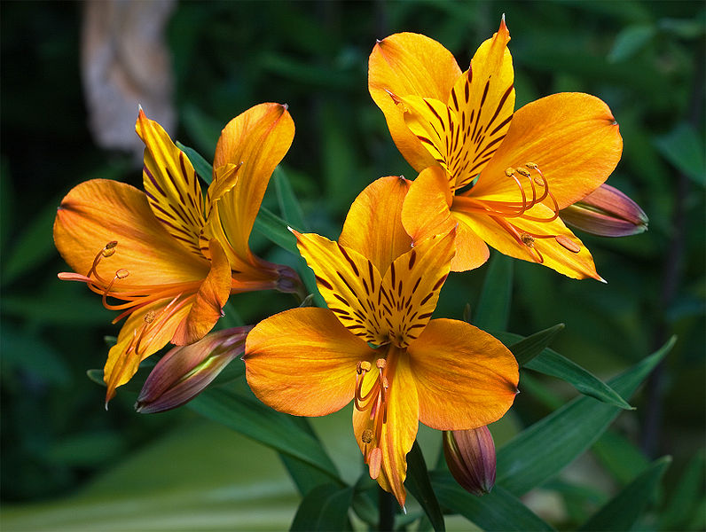
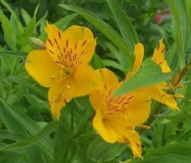
Alstroemeria aurantiaca Peruvian Lily

Slide 5
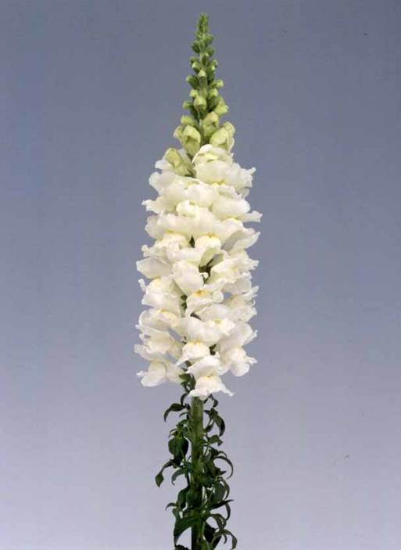
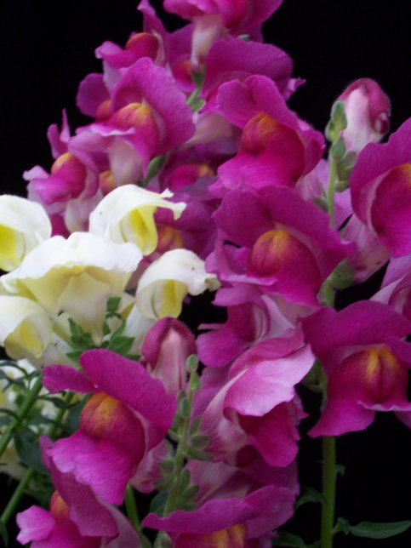
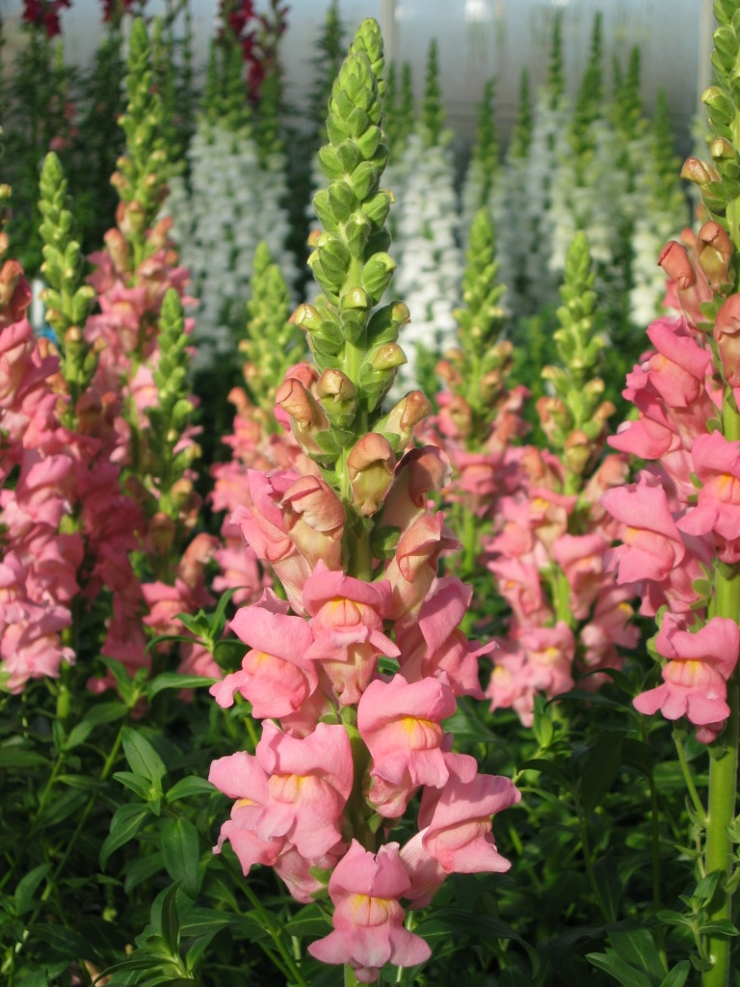
Anthirrhinum majus cv. Snapdragon

Slide 6
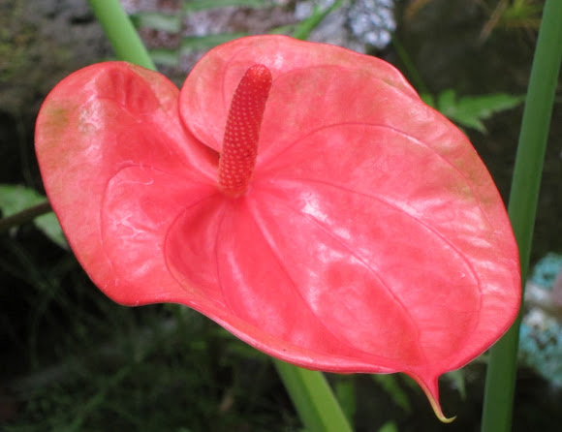
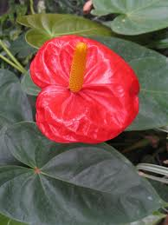
Anthurium x andraeanum cv. Anthurium, Flamingo Lily

Slide 7
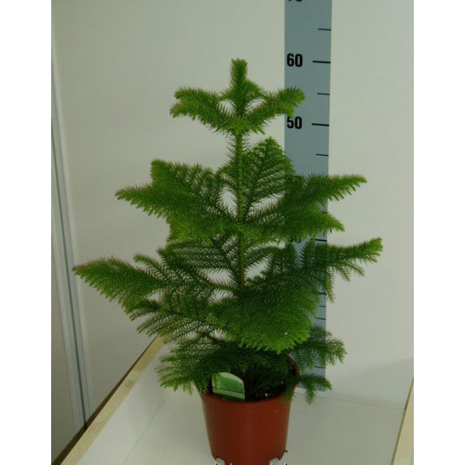
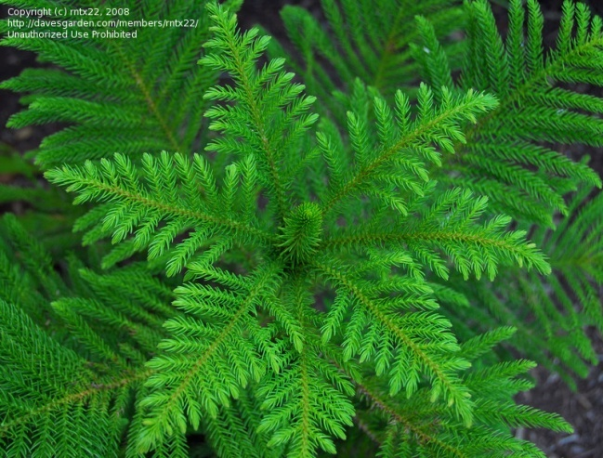
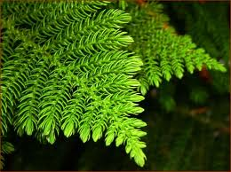
Araucaria heterophylla Norfolk Island Pine

Slide 8
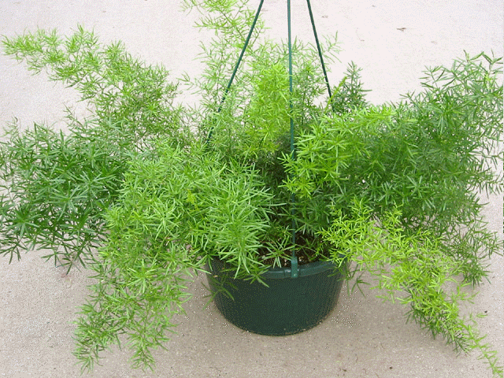
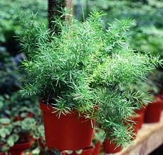
Asparagua densiflorous ‘Sprengri’ Sprengri, Fern

Slide 9
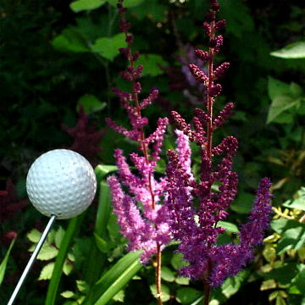
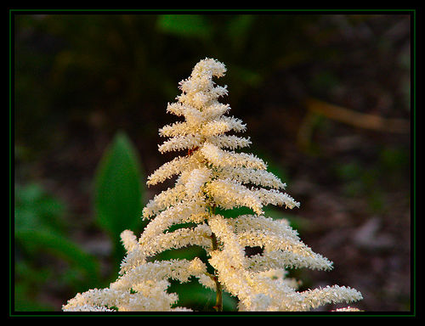
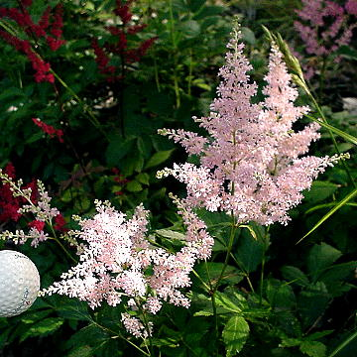
Astilbe hybrid cv. Astilbe

Slide 10
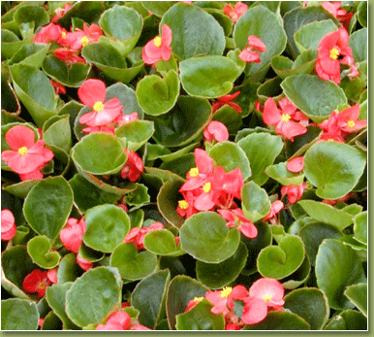
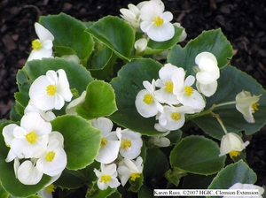
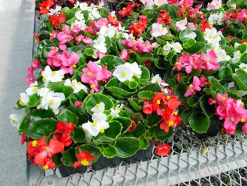
Begonia x semperflorens-cultorum Wax Begonia

Slide 11
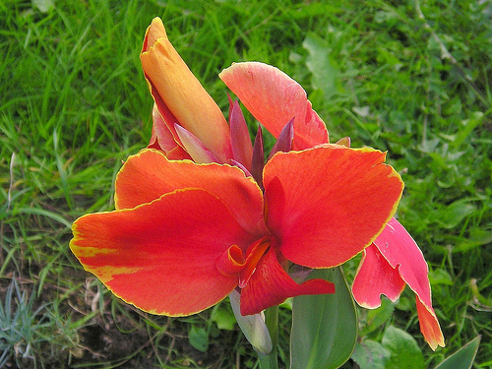
Canna x generalis cv. Common Garden Canna

Slide 12
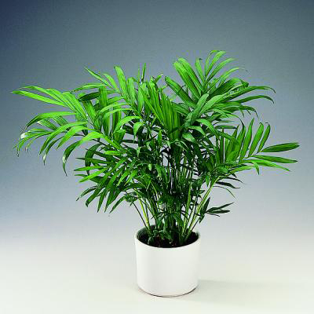
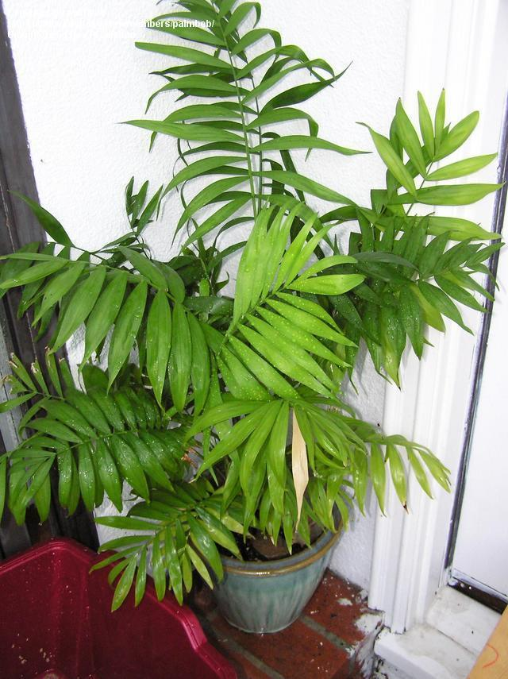
Chamaedorea elgans Parlor Palm

Slide 13
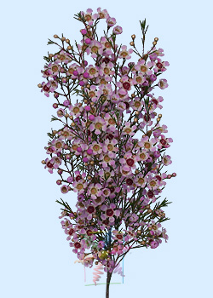
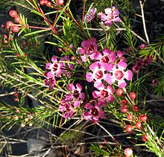
Chamelaucium unicinatum Waxflower

Slide 14
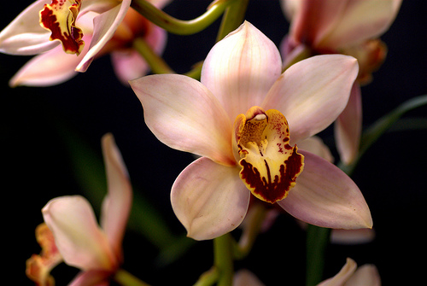
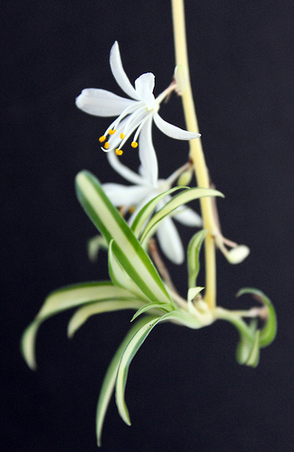
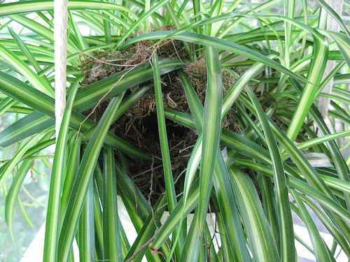
Chlorophytum commosum cv. Spider Plant

Slide 15
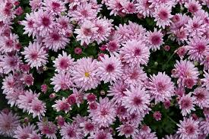
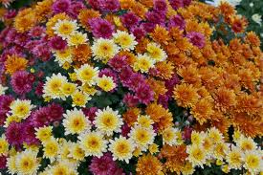
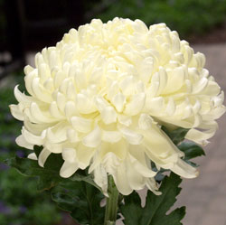
Chrysanthemum x morifolium cv. Florist’s Chrysanthemum

Slide 16
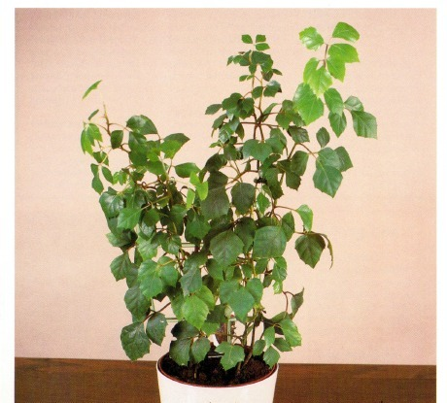
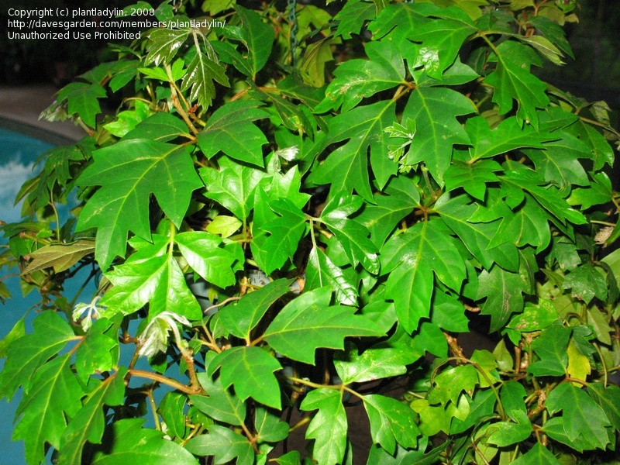
Cissus rhombifolia “mandaiana” Grape Ivy

Slide 17
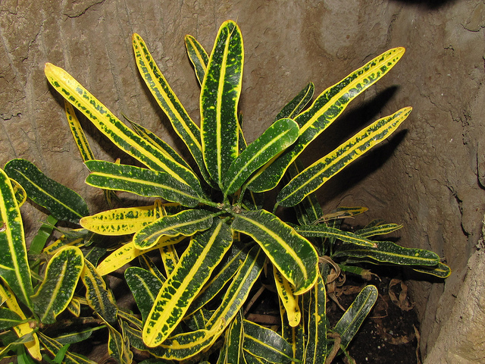
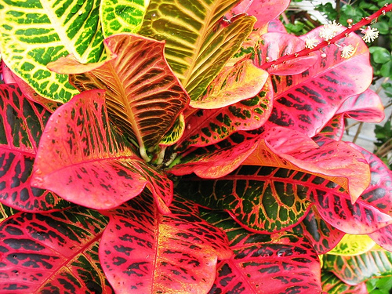
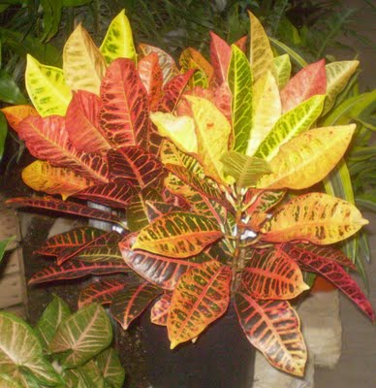
Codiaeum variegatum pictum cv. Croton

Slide 18
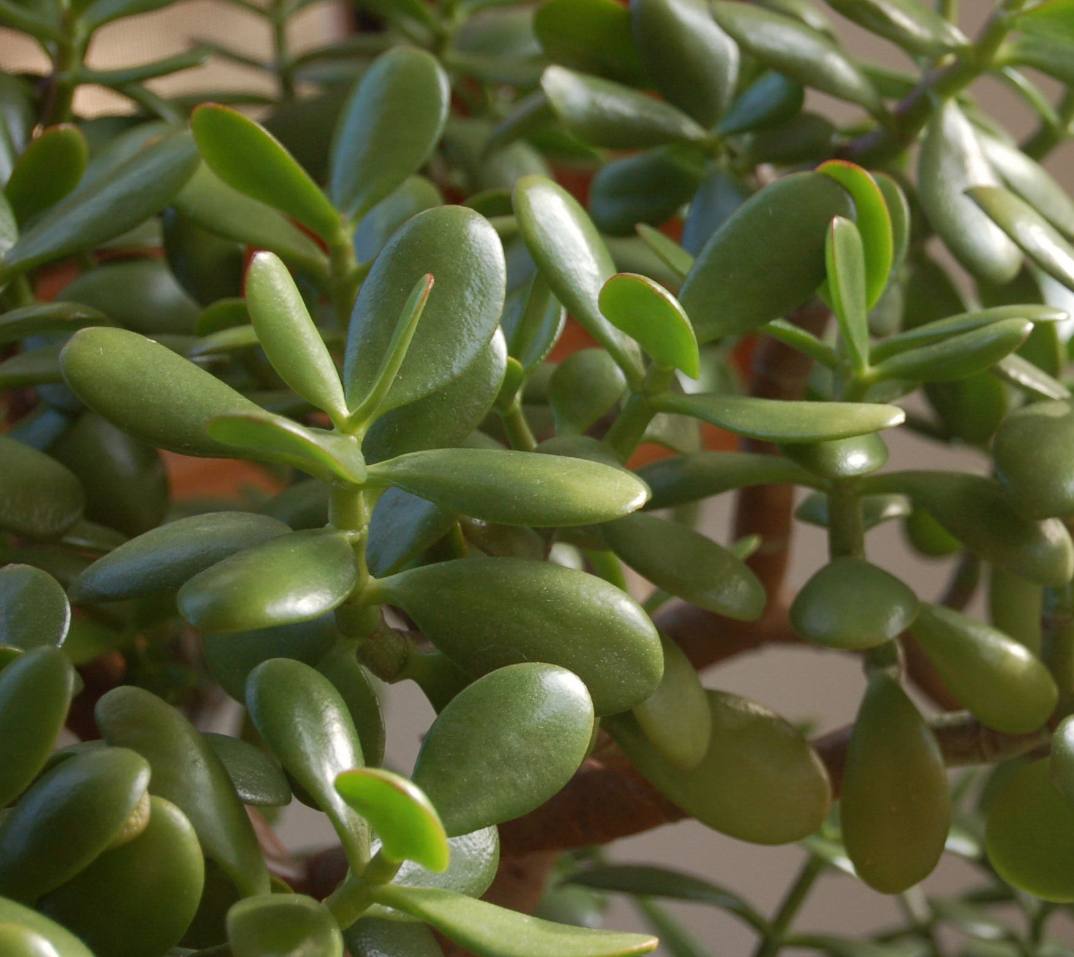
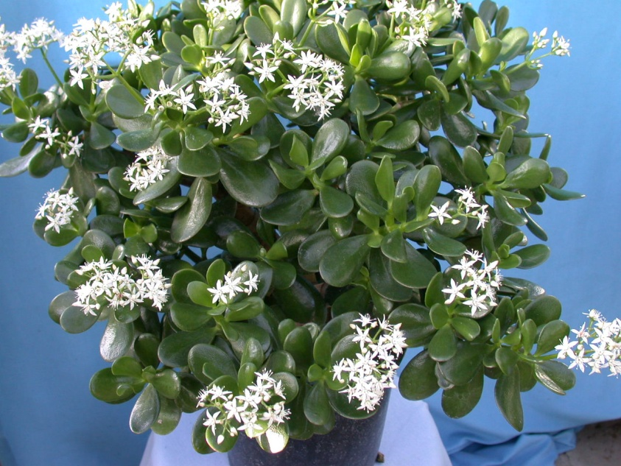
Crassula argentea Jade Plant

Slide 19
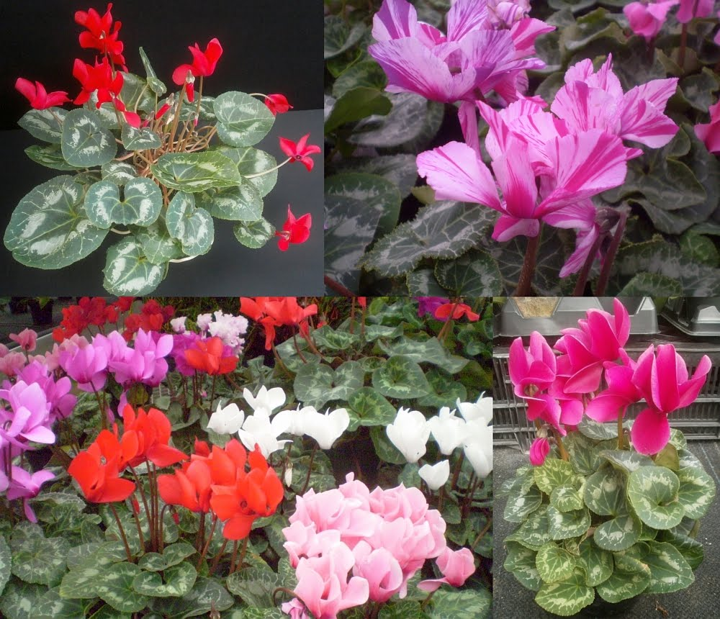
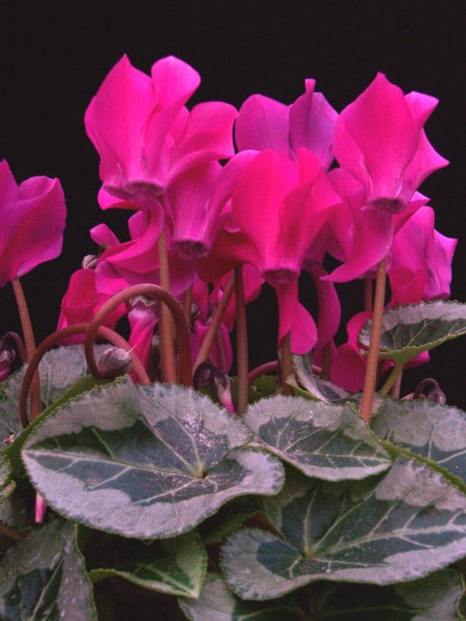
Cyclamen x persicum cv. Florist’s Cyclamen

Slide 20
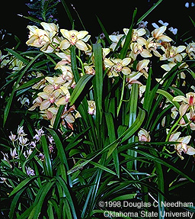
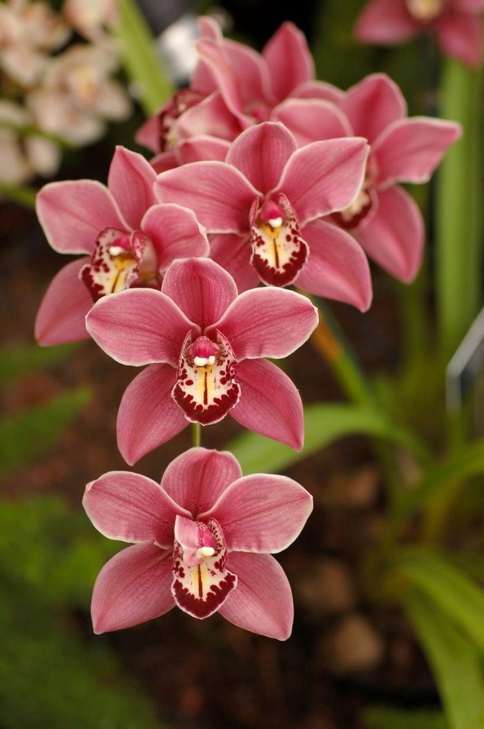
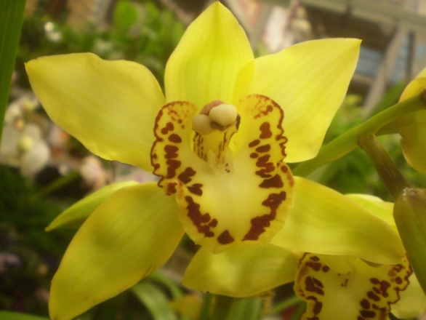
Cymbidium cv. Cymbidium Orchid

Slide 21
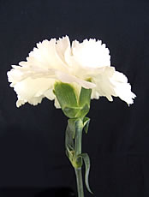
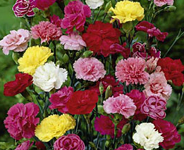
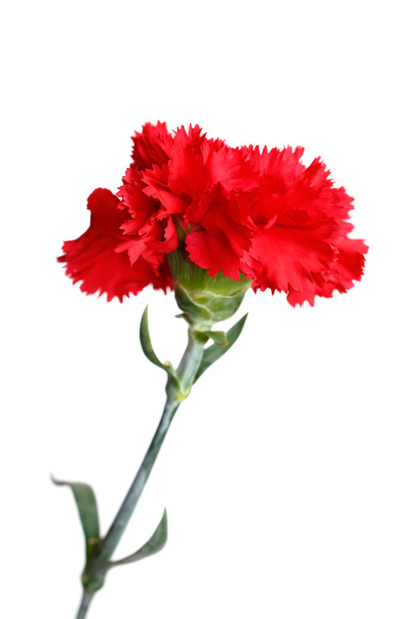
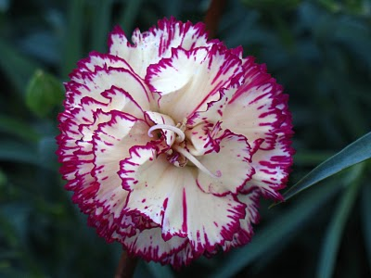
Dianthus caryophylus cv. Carnation

Slide 22
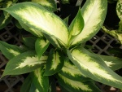
Dieffenbachia maculata cv. Spotted Dumbcane

Slide 23
Dracaena fragrans ‘Massangeana’ Corn Plant Draceana

Slide 24
Echeveria cv. Hens and Chickens

Slide 25
Epipremnum aureum Golden Pothos, Devil’s Ivy

Slide 26
Evacum affine German (Persian) Violet

Slide 27
Ficus benjamina ‘Exotica’ Benjamin Fig

Slide 28
Ficus elastic ‘Decora’ ‘Decora’ Rubber Plant

Slide 29
Freesia x hybrid Freesia

Slide 30
Gerbera jamesonii Transvaal Daisy

Slide 31
Gladiolus x hortulanus cv. Garden Gladiulus

Slide 32
Gypsophila elegans’ cv. Baby’s Breath

Slide 33
Hedera helix cv. English Ivy

Slide 34
Hosta undulate Plantain Lily

Slide 35
Hoya carnosa Wax Plant

Slide 36
Hyacinthus orientalis cv. Hyacinth

Slide 37
Hydrangea macraphylla macrophylla cv. French (Florist’s) Hydrangea

Slide 38
Iris x xiphium cv. Dutch Iris

Slide 39
Kalanchoe x blossfeldiana cv. Kalanchoe

Slide 40
Liatris spicta Liatris

Slide 41
Lilium x hybridium cv. Hybrid (Garden) Lily

Slide 42
Limonium sinuatum Statice

Slide 43
Matthiola incana cv. Flowering Stock

Slide 44
Monstera deliciosa Cutleaf “Philendron”

Slide 45
Narcissus pseudo-narcissus cv. Daffodil

Slide 46
Nephrolepis exaltata cv. Boston Fern

Slide 47
Opuntia tribe cv. Cactus

Slide 48
Pelargonium x hortorum cv. Zonal Geranium

Slide 49
Pelargonium peltatum cv. Ivy Geranium

Slide 50
Peperomia caperata Emerald Ripple Peperomia

Slide 51
Petunia x hybrid cv. Common Garden Petunia

Slide 52
Phalaenopsis cv. Phalaenopsis (Butterfly) Orchid

Slide 53
Philodendron oxycardium Heartleaf Philodendron

Slide 54
Pilea microphylla Artillery Plant

Slide 55
Plectranthus nummularis Swedish Ivy

Slide 56
Primula x polanthus cv. Polyanthus (Primrose)

Slide 57
Rhododendron cv. Azalea

Slide 58
Rosa hybrid, Class Hybrid Tea cv. Hybrid Tea Rose

Slide 59
Rumohra adianthiformis Leatherleaf Fern

Slide 60
Saintpaulia ionantha cv. African Violet

Slide 61
Sansevieria trifasciata cv. Snake Plant

Slide 62
Senecio x hybridus cv. Florist’s Cineraria

Slide 63
Sinningia speciosa Fyfiana Group cv. Gloxinia

Slide 64
Syngonium podophyllum Nephthytis

Slide 65
Tagetes species cv. Marigold

Slide 66
Solenostemon hybrid Coleus

Slide 67
Spathiphyllum clevelandii White Anthurium, Peace Lily

Slide 68
Stephanotis floribunda Stephanotis

Slide 69
Sterlitzia reginae Bird-of-Paradise

Slide 70
Tulipia cv. Tulip

Slide 71
Viola x wittrockiana cv. (Garden) Pansy

Slide 72
Zebrina pendula cv. Wandering Jew

Slide 73
Equipment

Slide 74
Boutonniere Pin

Slide 75
Corsage Pin

Slide 76
Corsage Stem

Slide 77
Corsage Tape

Slide 78
Glue Gun

Slide 79
Glue Pan

Slide 80
Knife Sharpener

Slide 81
Paddle Wire

Slide 82
Pruner

Slide 83
Ribbon Scissor

Slide 84
Rose Stripper

Slide 85
Steel Pick Machine

Slide 86
Styrofoam Cutter

Slide 87
Under Water Cutter

Slide 88
Waterproof Tape

Slide 89
Wire Cutters

Slide 90
Wristlet

