Slide 1
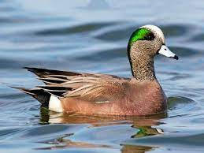

Slide 2
American Wigeon

Slide 3
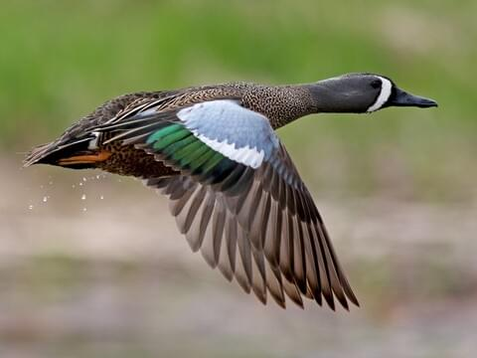

Slide 4
Blue-winged Teal

Slide 5
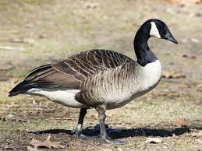

Slide 6
Canada Goose

Slide 7
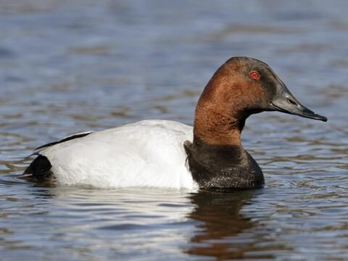

Slide 8
Canvasback

Slide 9
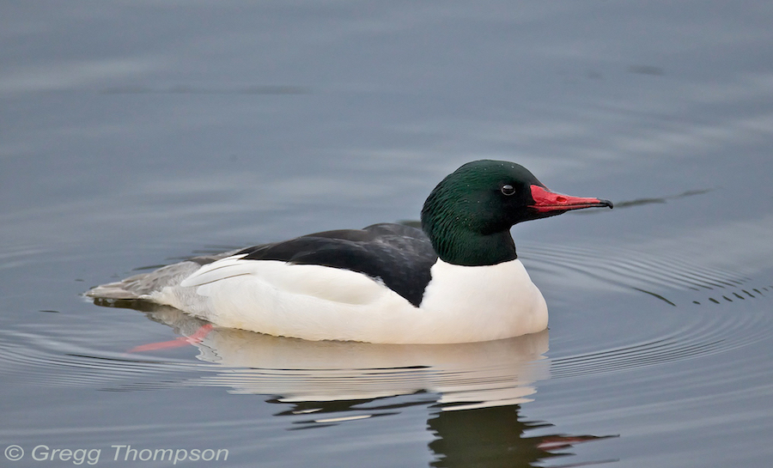

Slide 10
Common Merganser

Slide 11
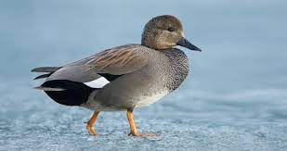

Slide 12
Gadwall

Slide 13
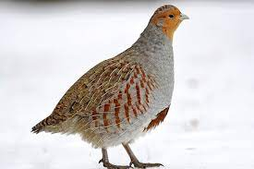

Slide 14
Gray Partridge

Slide 15
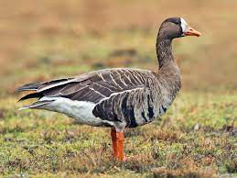

Slide 16
Greater White Fronted Goose

Slide 17
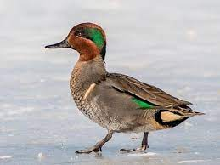

Slide 18
Green-winged Teal

Slide 19
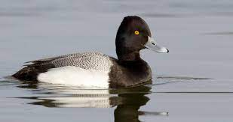

Slide 20
Lesser Scaup

Slide 21
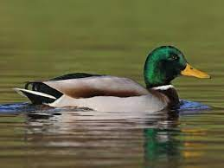

Slide 22
Mallard

Slide 23
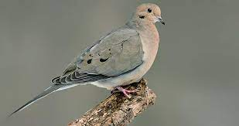

Slide 24
Mourning Dove

Slide 25
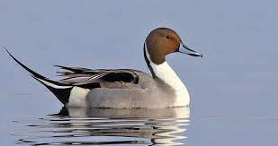

Slide 26
Northern Pintail

Slide 27
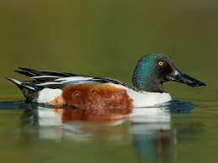

Slide 28
Northern Shoveler

Slide 29
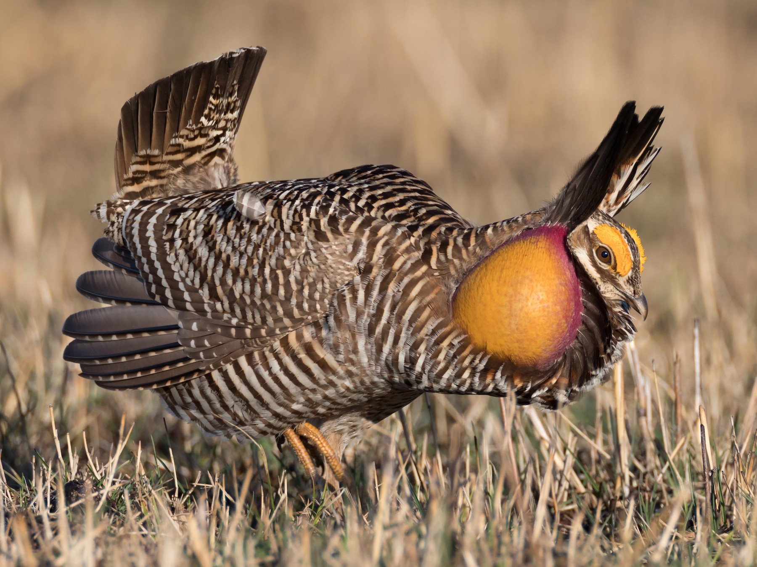

Slide 30
Greater Prairie Chicken

Slide 31
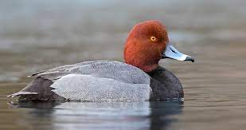

Slide 32
Redhead

Slide 33
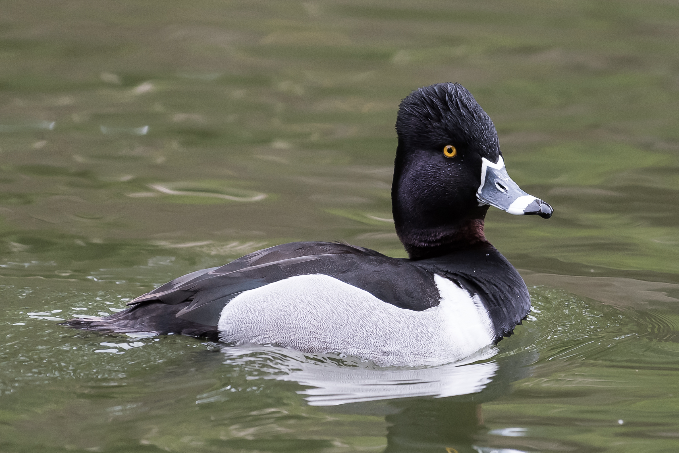

Slide 34
Ring-necked duck

Slide 35
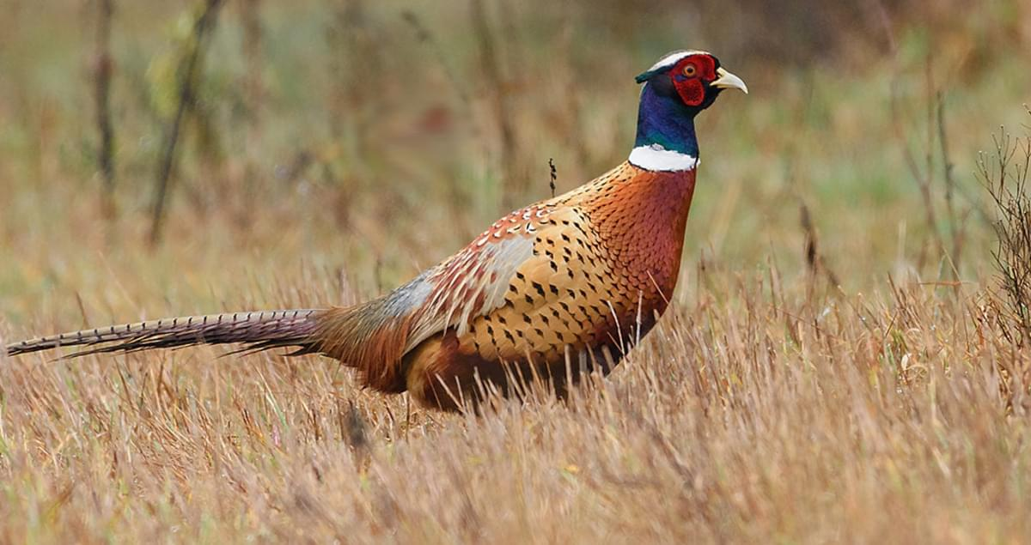

Slide 36
Ring-necked Pheasant

Slide 37
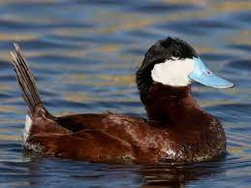

Slide 38
Ruddy Duck

Slide 39
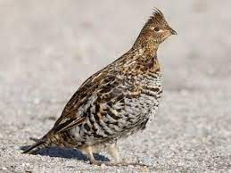

Slide 40
Ruffed Grouse

Slide 41
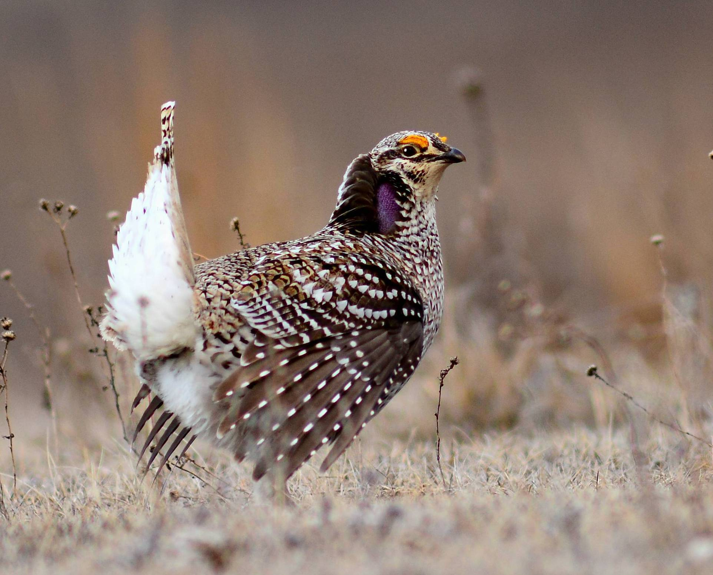

Slide 42
Sharp-tailed Grouse

Slide 43
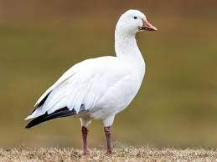

Slide 44
Snow Goose

Slide 45
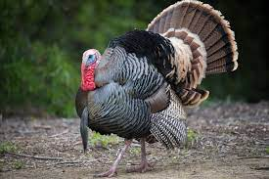

Slide 46
Wild Turkey

Slide 47
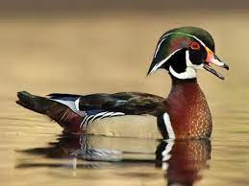

Slide 48
Wood Duck

Slide 49
Other Birds

Slide 50
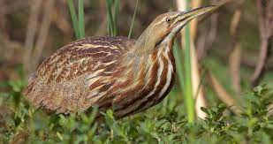

Slide 51
American Bittern

Slide 52
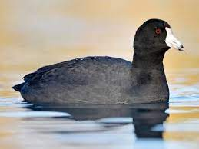

Slide 53
American Coot

Slide 54
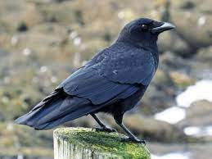

Slide 55
American Crow

Slide 56
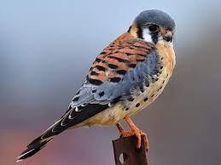

Slide 57
American Kestrel

Slide 58
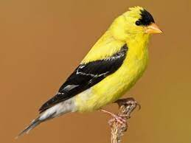

Slide 59
American Goldfinch

Slide 60
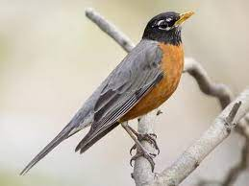

Slide 61
American Robin

Slide 62
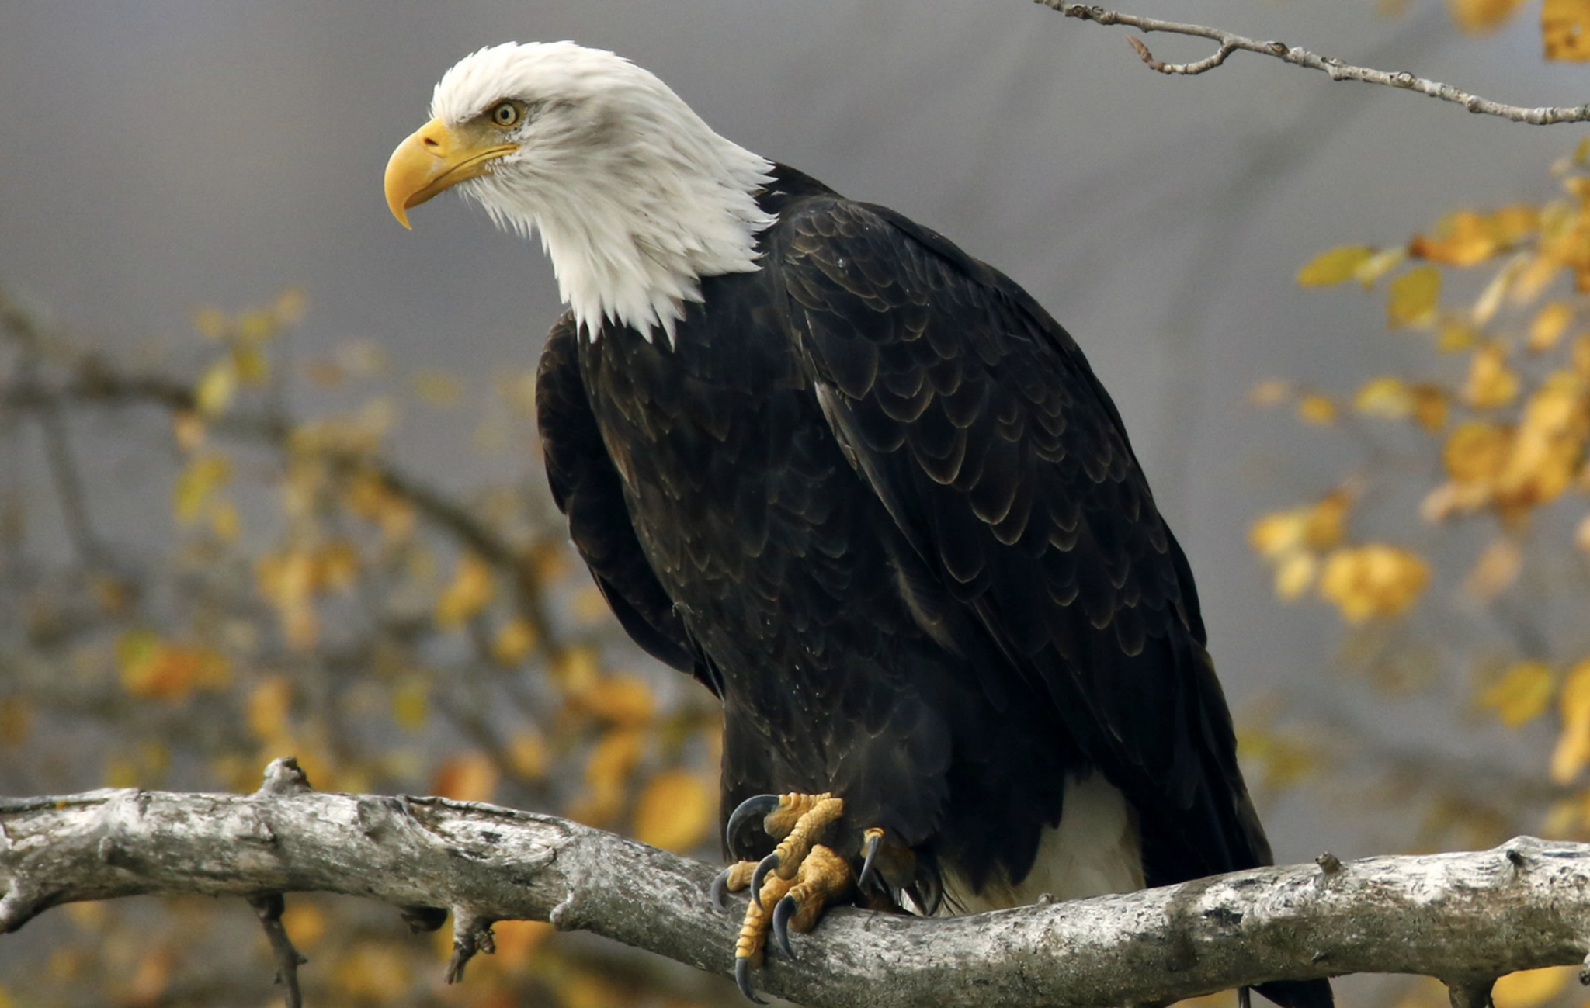

Slide 63
Bald Eagle

Slide 64
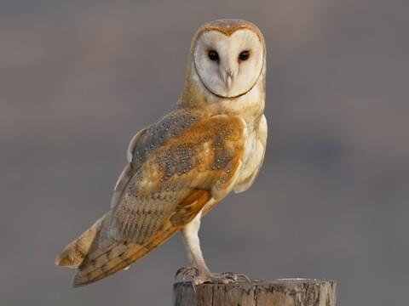

Slide 65
Barn Owl

Slide 66
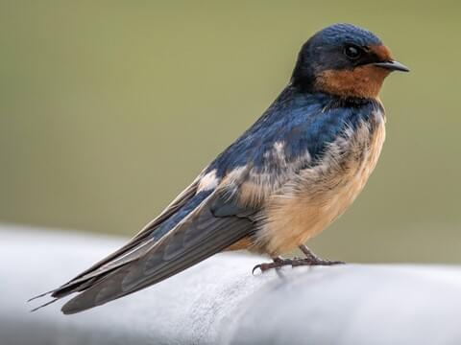

Slide 67
Barn Swallow

Slide 68
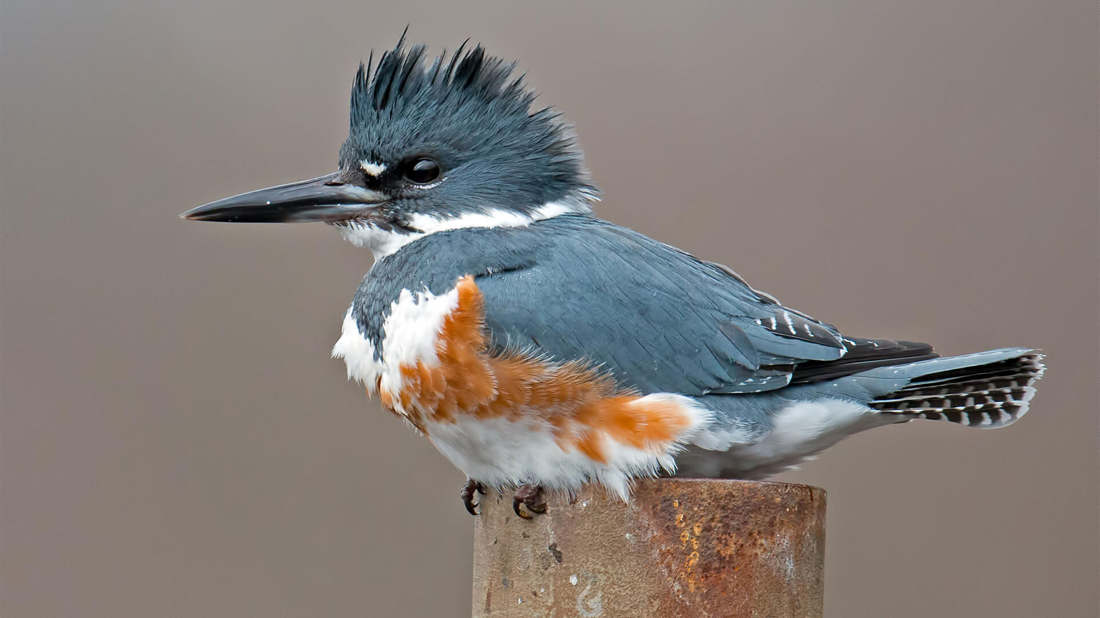

Slide 69
Belted Kingfisher

Slide 70
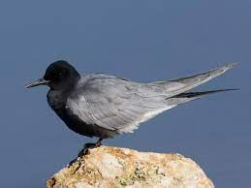

Slide 71
Black Tern

Slide 72
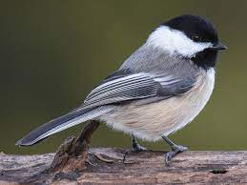

Slide 73
Black-Capped Chickadee

Slide 74
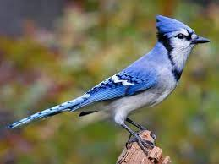

Slide 75
Blue Jay

Slide 76
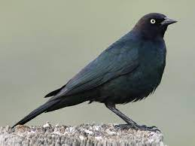

Slide 77
Brewer’s Blackbird

Slide 78
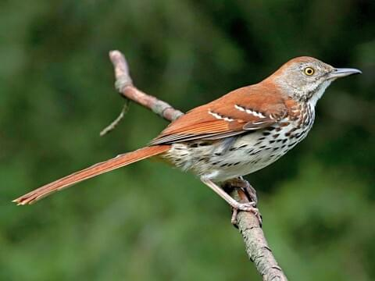

Slide 79
Brown Thrasher

Slide 80
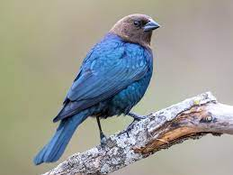

Slide 81
Brown-headed Cowbird

Slide 82
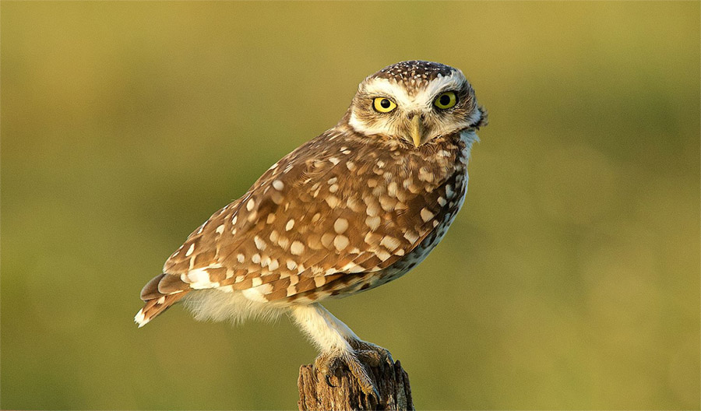

Slide 83
Burrowing Owl

Slide 84
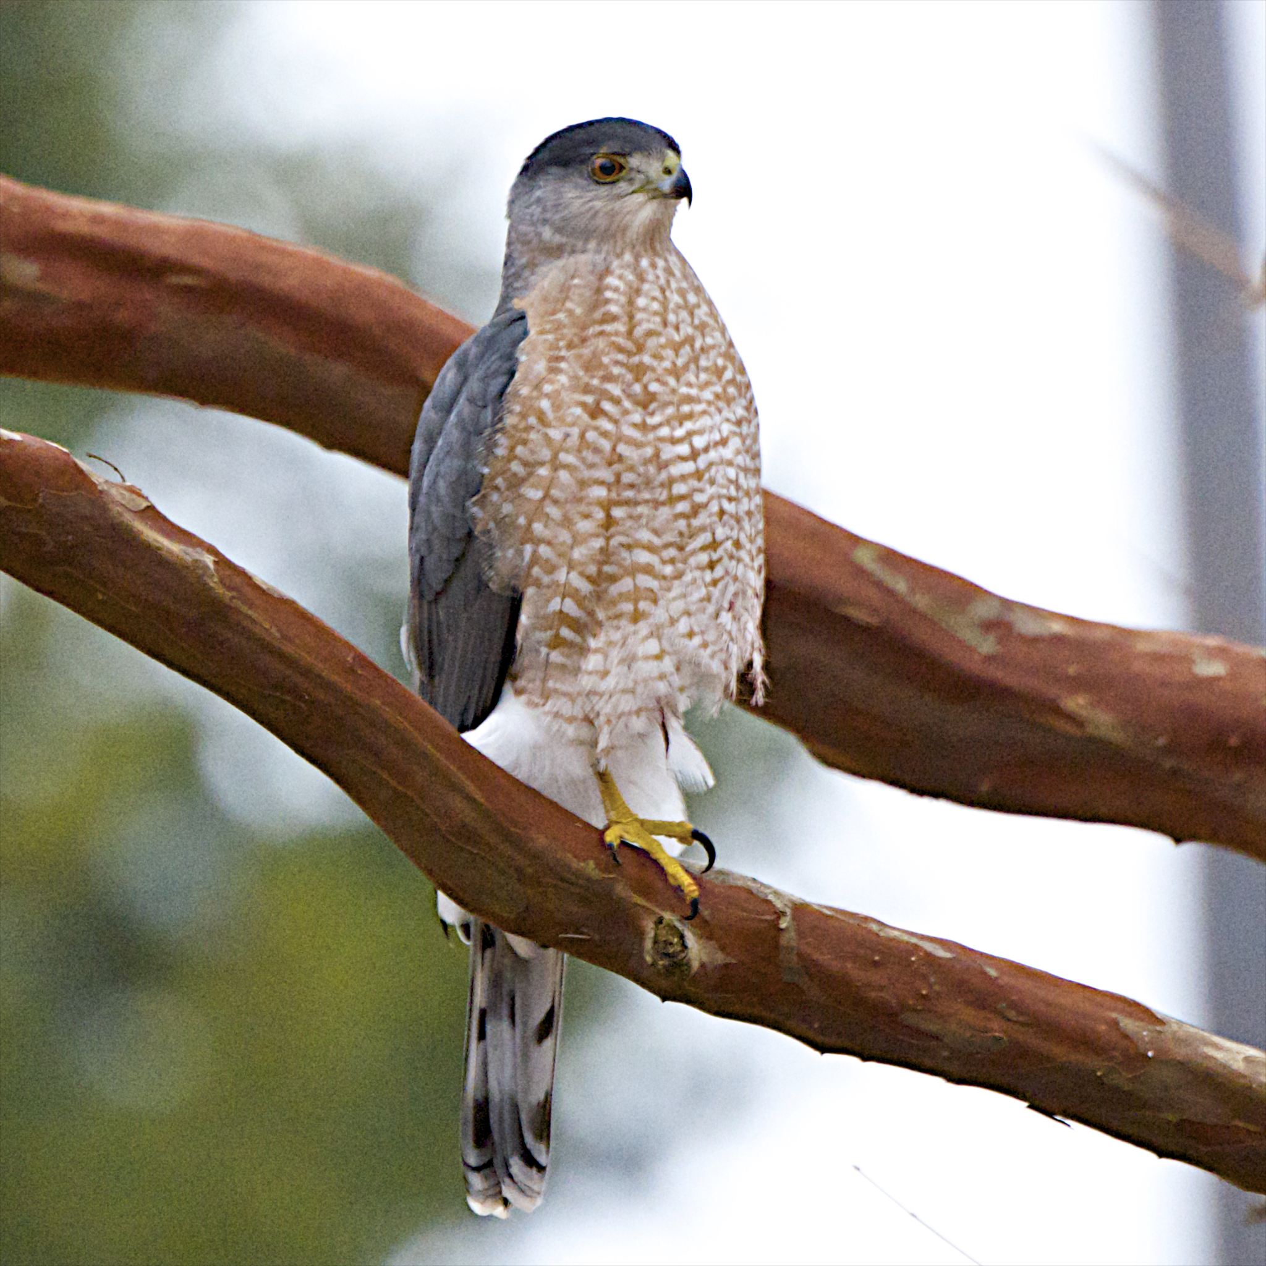

Slide 85
Cooper’s Hawk

Slide 86
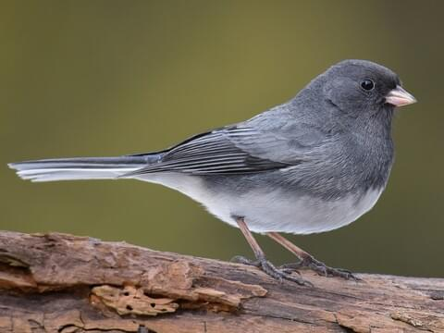

Slide 87
Dark-eyed Junco

Slide 88
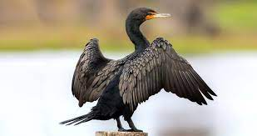

Slide 89
Double-crested Cormorant

Slide 90
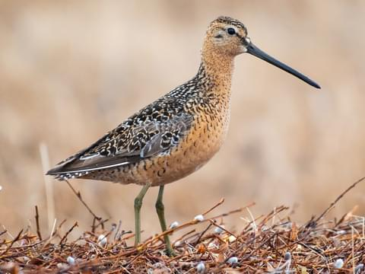

Slide 91
Long-billed Dowitcher

Slide 92
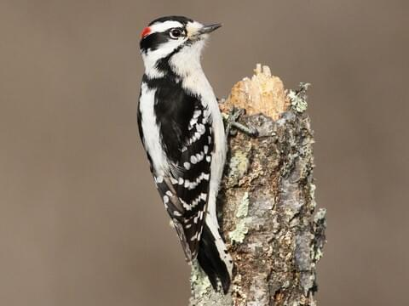

Slide 93
Downy Woodpecker

Slide 94
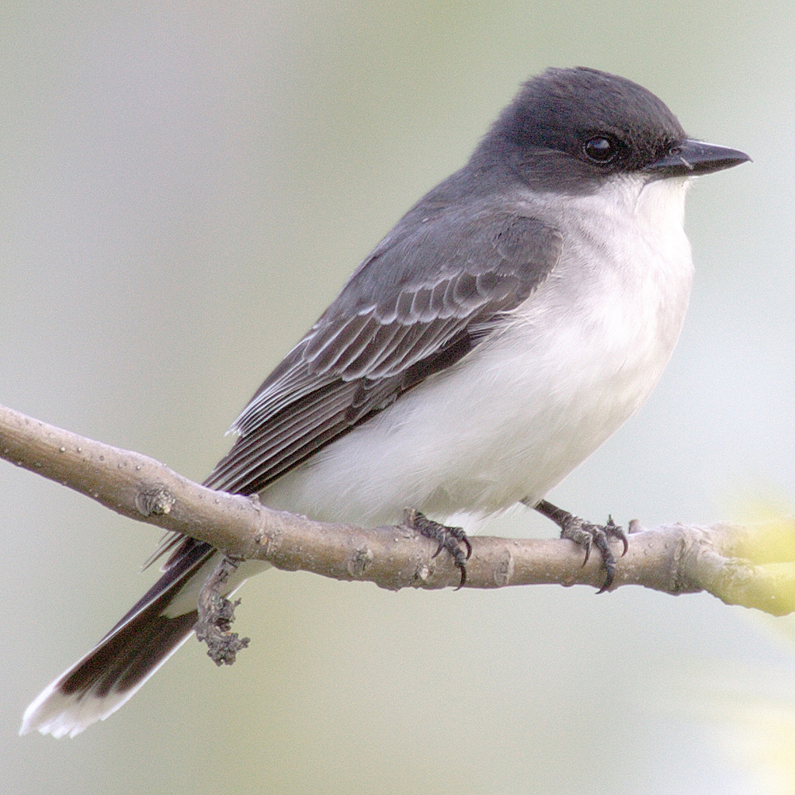

Slide 95
Eastern Kingbird

Slide 96
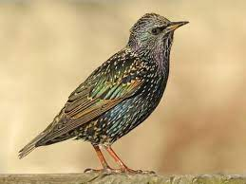

Slide 97
European Starling

Slide 98
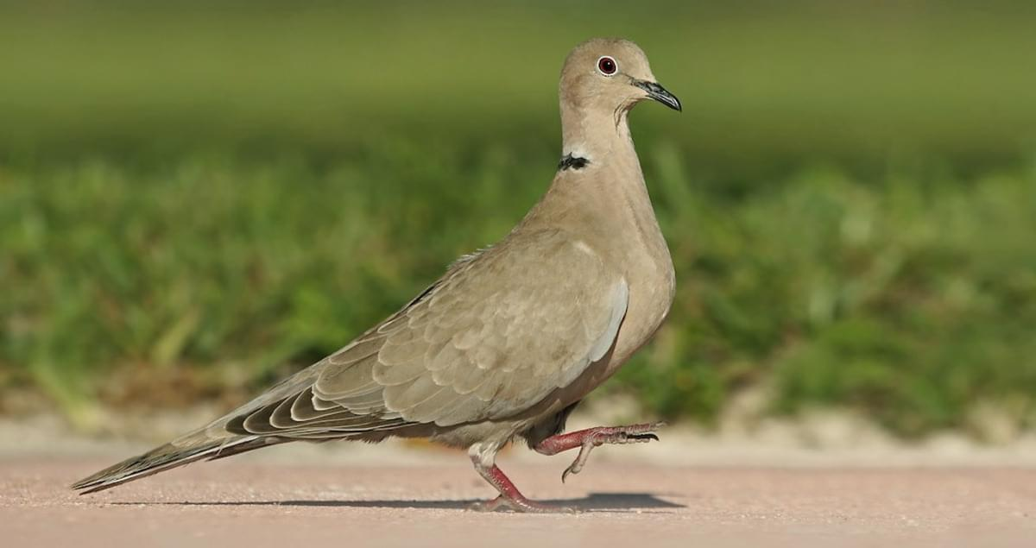

Slide 99
Eurasian Collared Dove

Slide 100
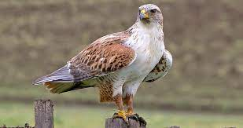

Slide 101
Ferruginous Hawk

Slide 103
Franklin’s Gull

Slide 105
Golden Eagle

Slide 107
Great Blue Heron

Slide 109
Great Egret

Slide 111
Great Horned Owl

Slide 113
Horned Lark

Slide 115
House Finch

Slide 117
House Sparrow

Slide 119
Peregrine Falcon

Slide 121
Pine Siskin

Slide 123
Piping plover

Slide 125
Purple Martin

Slide 127
Red-headed Woodpecker

Slide 129
Red-tailed Hawk

Slide 131
Red-winged Blackbird

Slide 133
Ring-billed Gull

Slide 135
Rough-legged Hawk

Slide 137
Ruby-throated Hummingbird

Slide 139
Eastern Screech Owl

Slide 141
Short-eared Owl

Slide 143
Swainson’s Hawk

Slide 145
Tree Swallow

Slide 147
Tundra Swan

Slide 149
Upland Sandpiper

Slide 151
Western Meadowlark

Slide 153
Common Flicker

Slide 155
House Wren

Slide 157
White Pelican

Slide 159
Common Grackle

Slide 161
Common Loon

Slide 163
Common Nighthawk

Slide 165
Common Redpoll

Slide 167
Common Snipe

Slide 169
Common Tern

Slide 171
Killdeer

Slide 173
Least Tern

Slide 175
Long-billed Curlew

Slide 177
Marbled Godwit

Slide 179
Northern Harrier

Slide 181
Oriole

Slide 183
White-breasted Nuthatch

Slide 185
Willet

Slide 187
Wilson’s Phalarope

Slide 189
Yellow-headed Blackbird

Slide 191
Yellow Warbler

Slide 193
Yellowlegs

