Slide 1
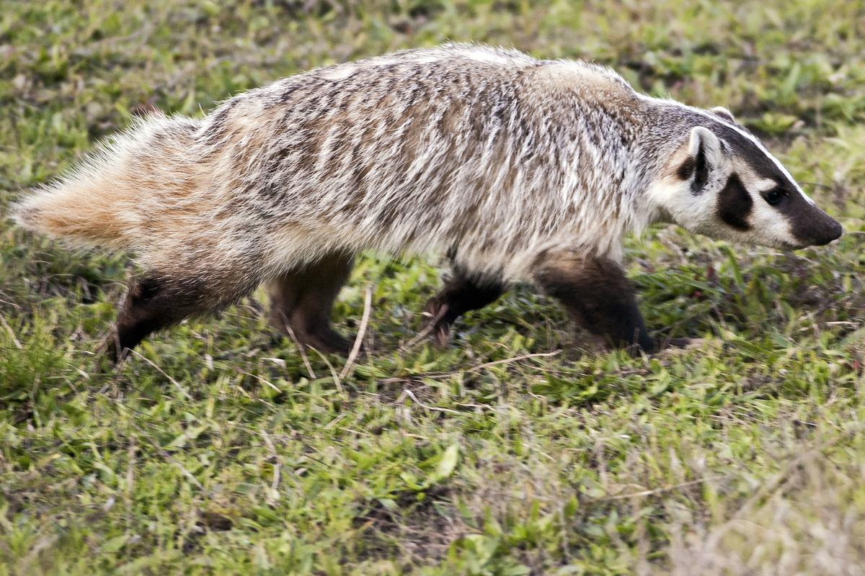

Slide 2
Badger

Slide 3
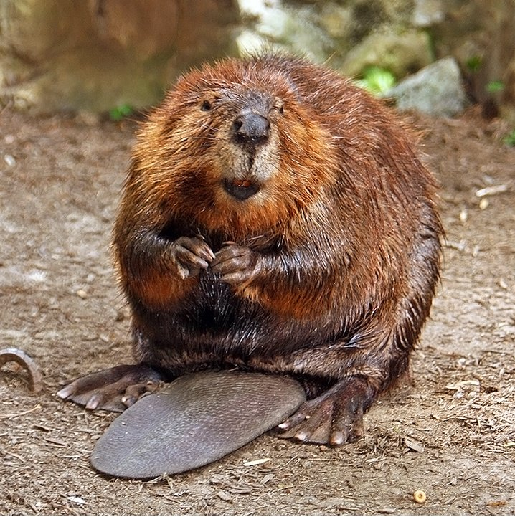

Slide 4
North American Beaver

Slide 5
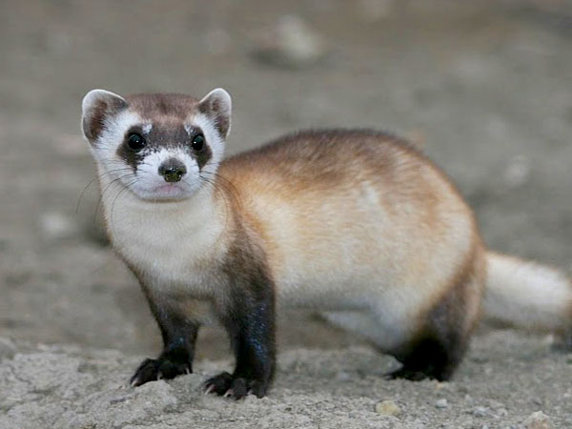

Slide 6
Black-footed ferret

Slide 7
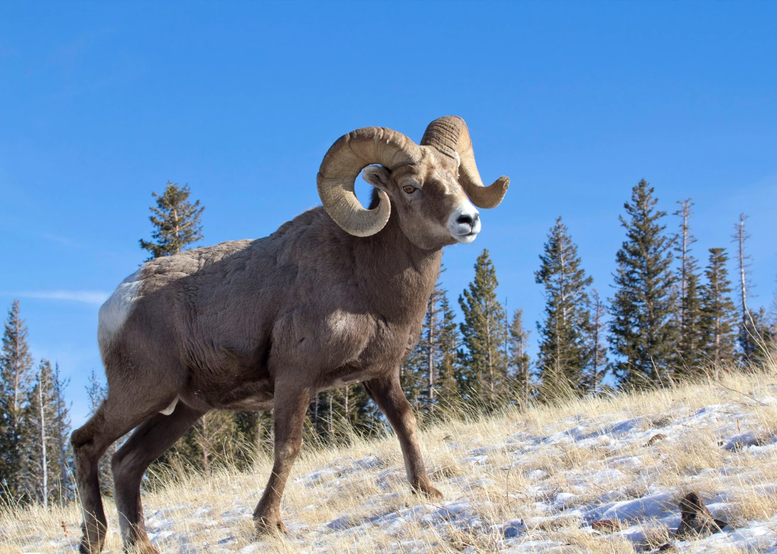

Slide 8
Bighorn Sheep

Slide 9
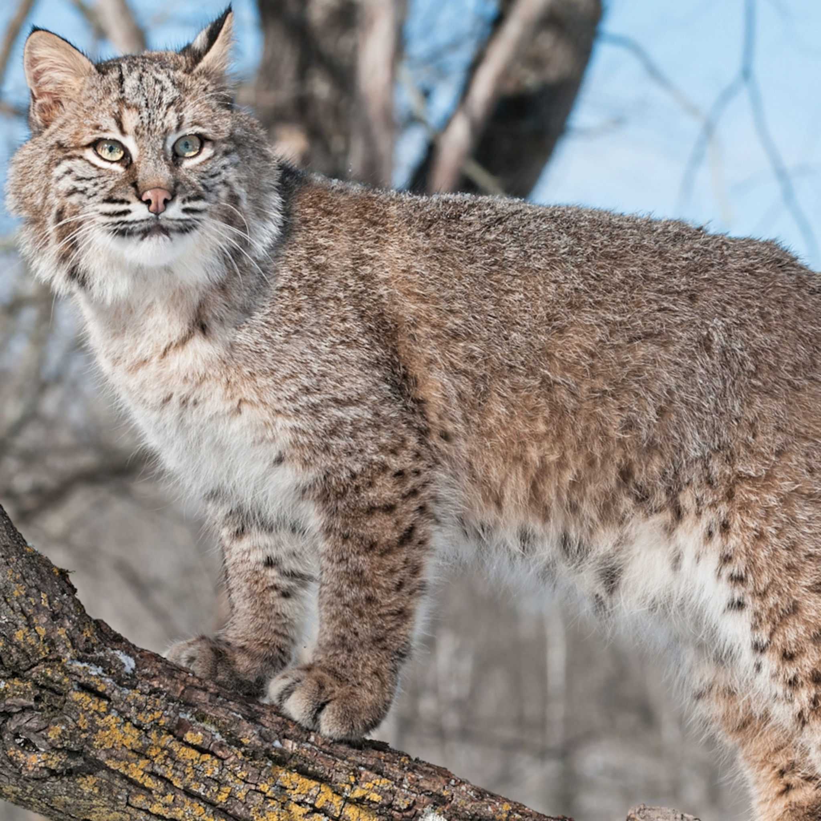

Slide 10
Bobcat

Slide 11
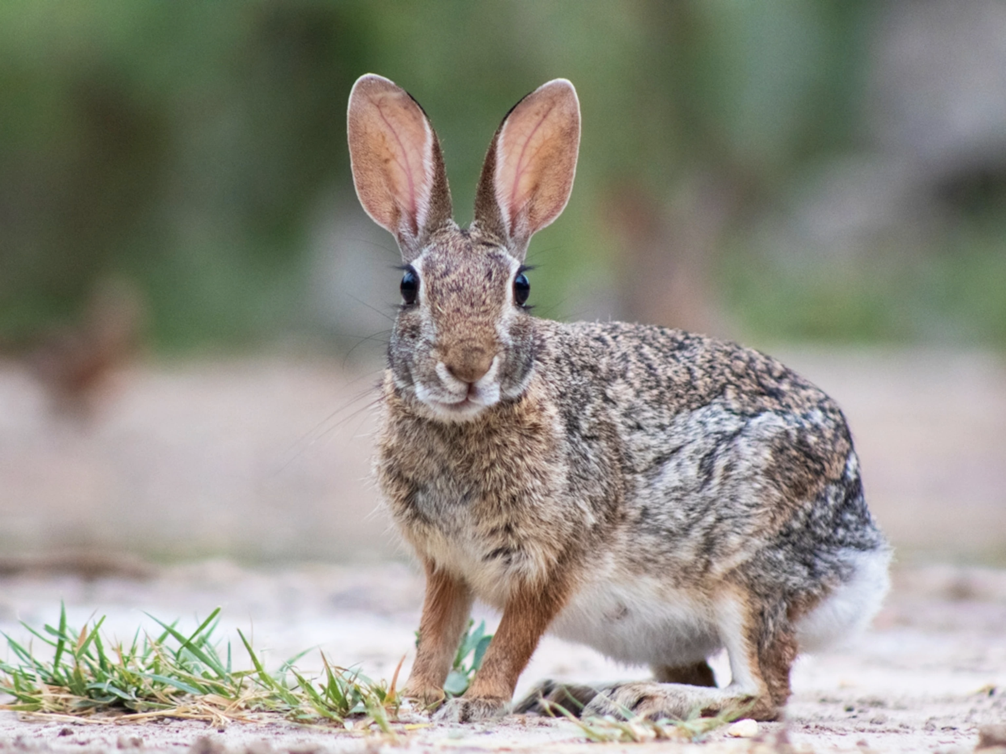

Slide 12
Eastern Cottontail

Slide 13
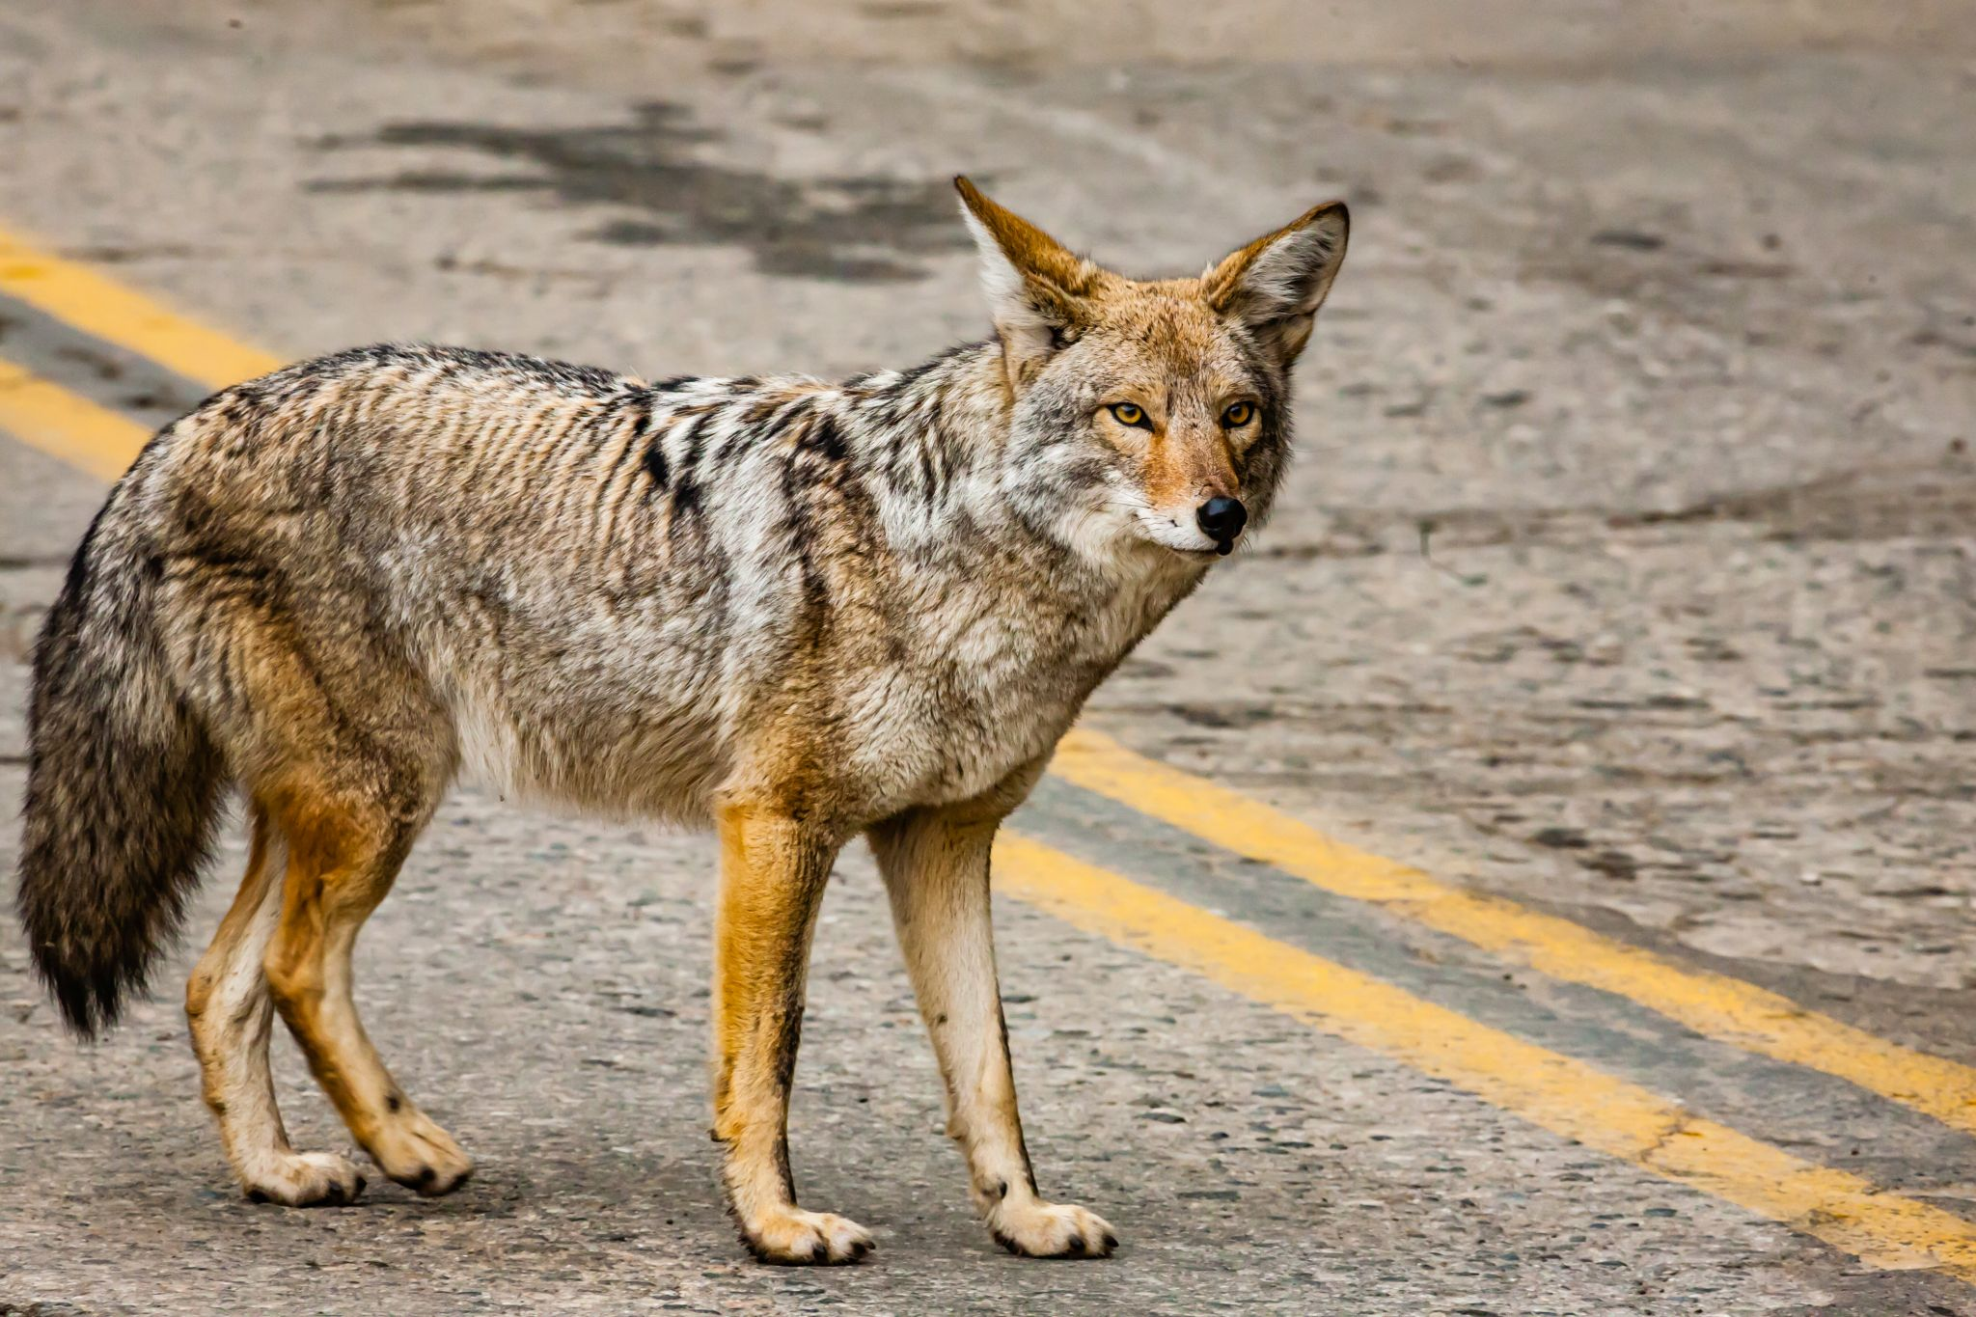

Slide 14
Coyote

Slide 15
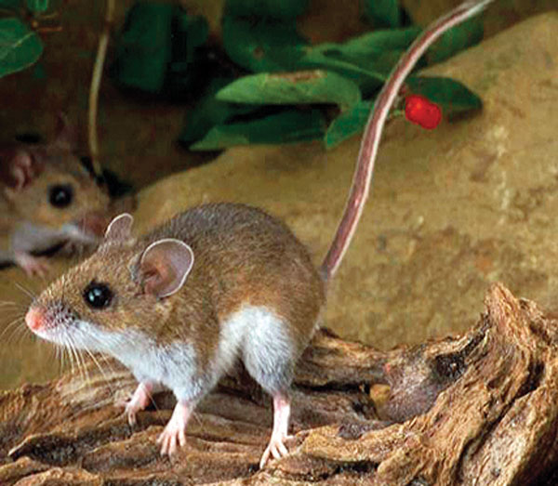

Slide 16
Deer Mouse

Slide 17
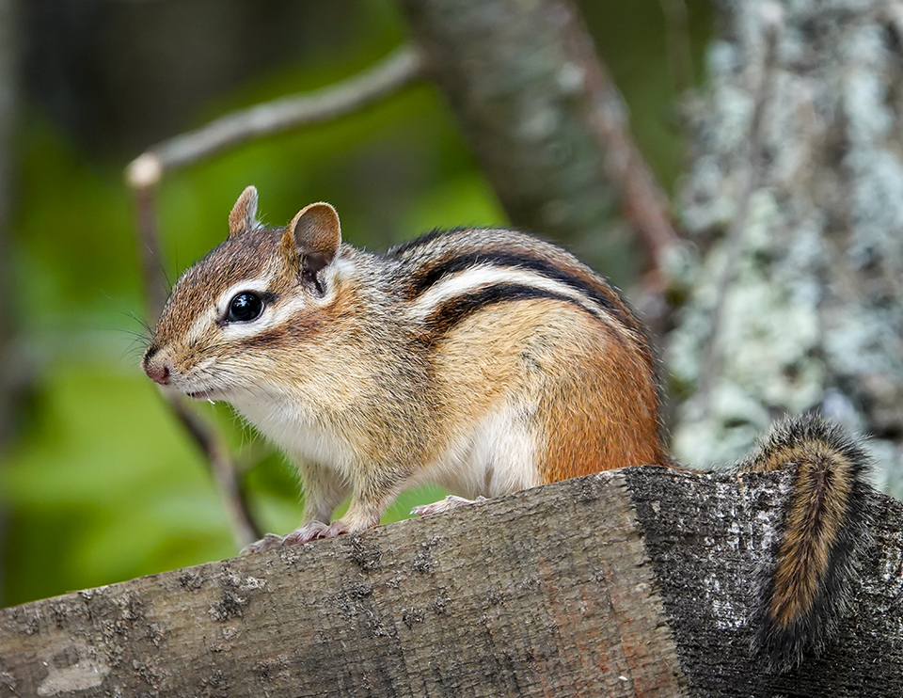

Slide 18
Eastern Chipmunk

Slide 19
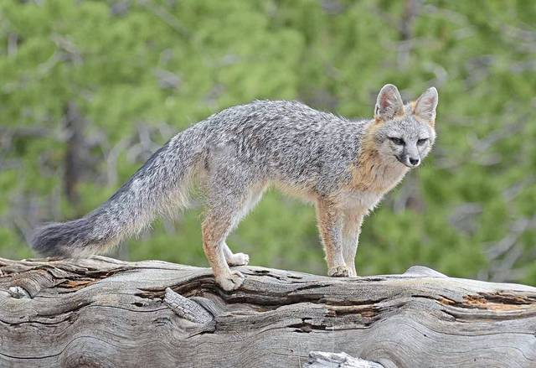

Slide 20
Grey Fox

Slide 21
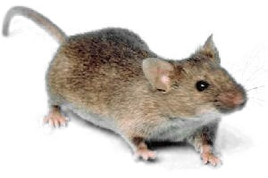

Slide 22
House Mouse

Slide 23
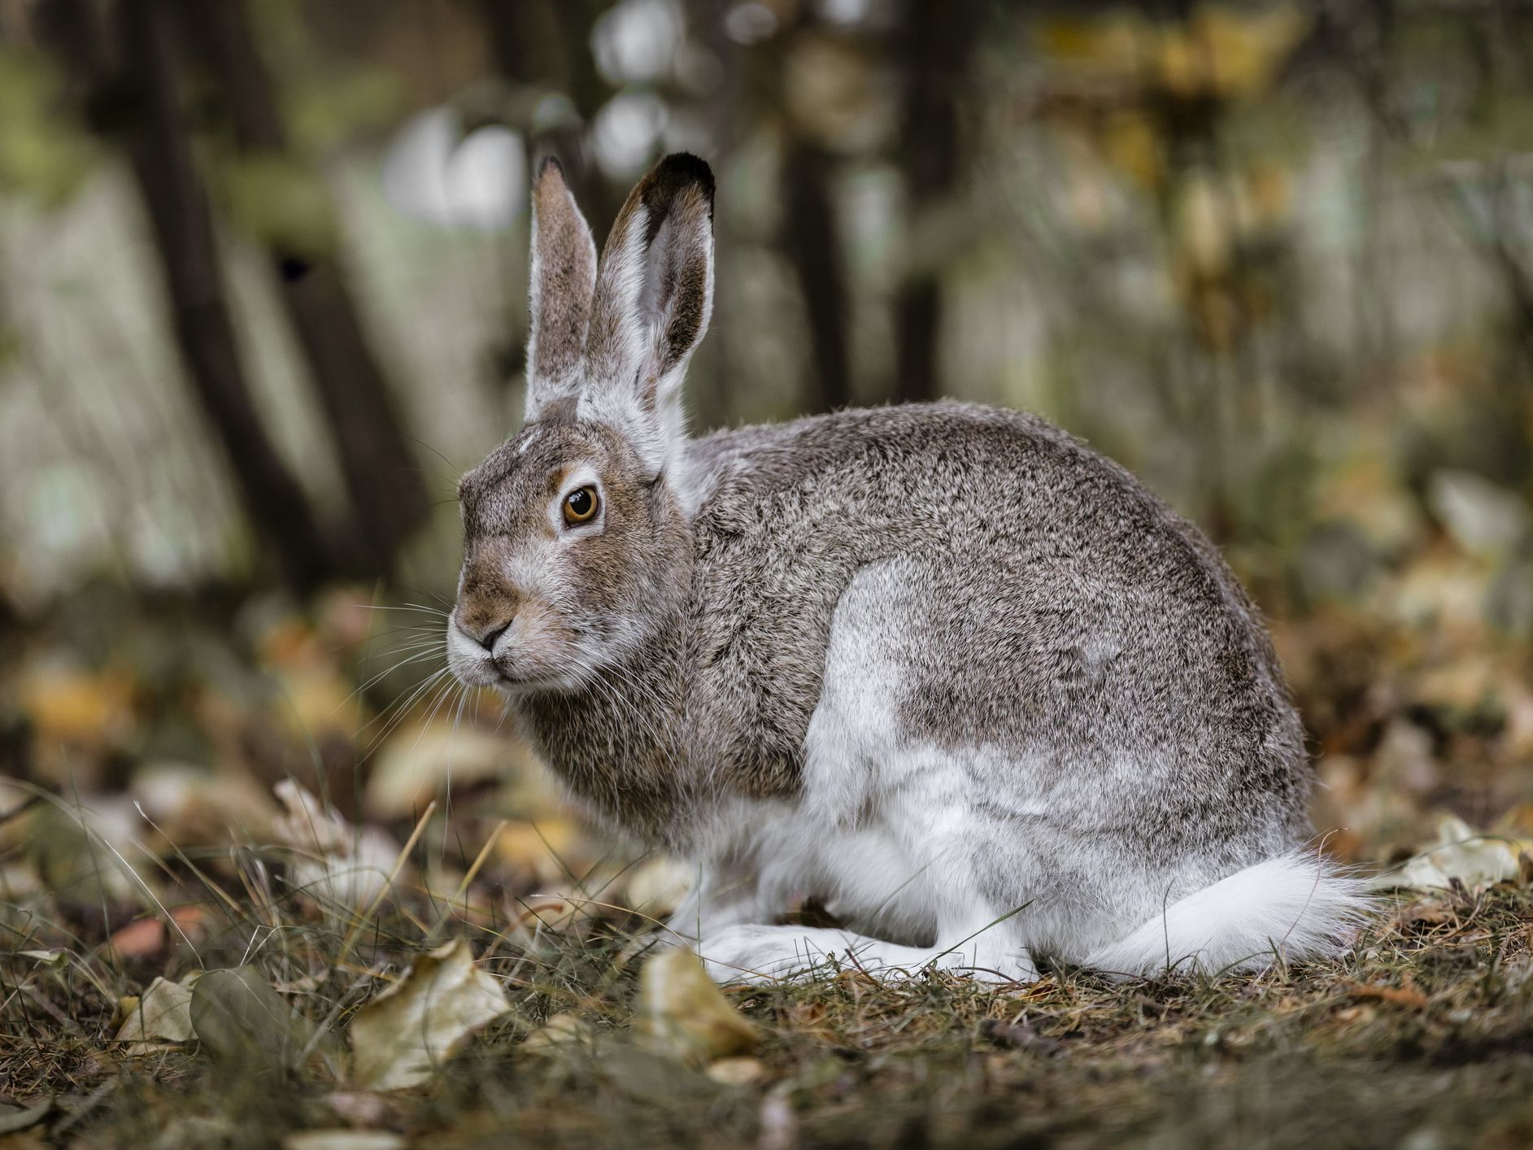

Slide 24
White-tailed Jackrabbit

Slide 25
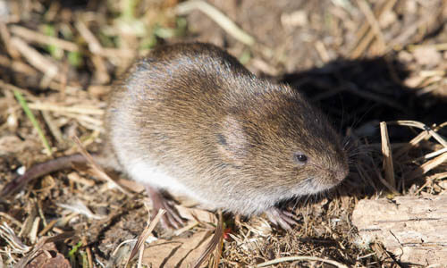

Slide 26
Meadow vole

Slide 27
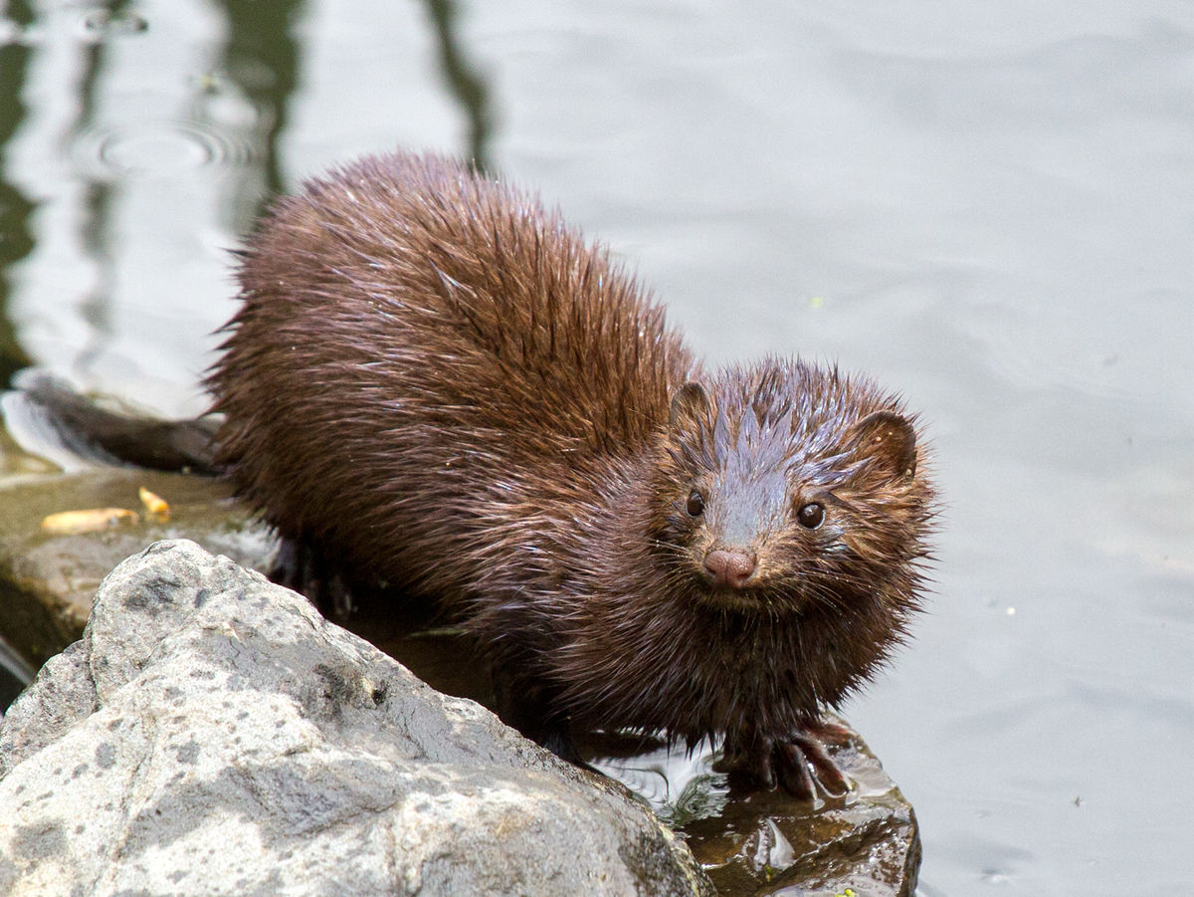

Slide 28
American Mink

Slide 29
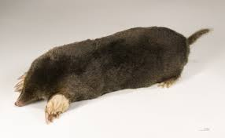

Slide 30
Common Mole

Slide 31
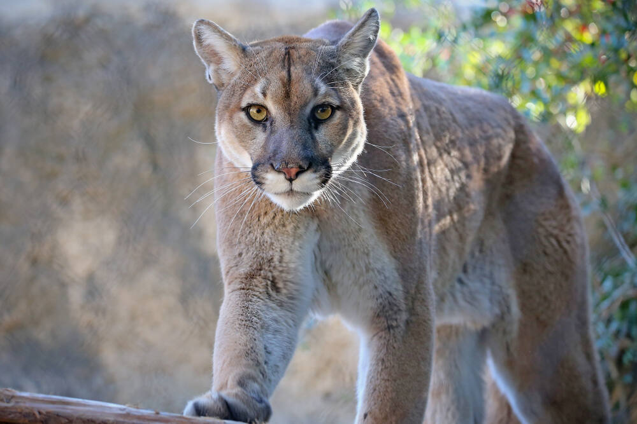

Slide 32
Mountain Lion

Slide 33
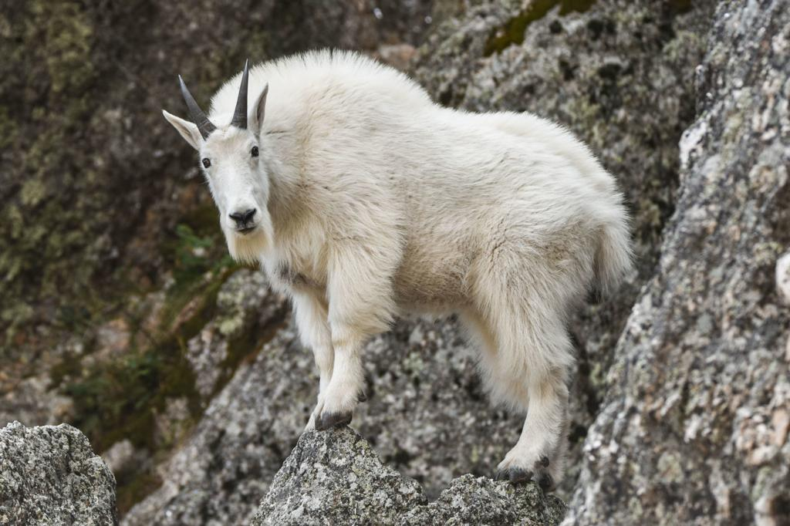

Slide 34
Mountain Goat

Slide 35
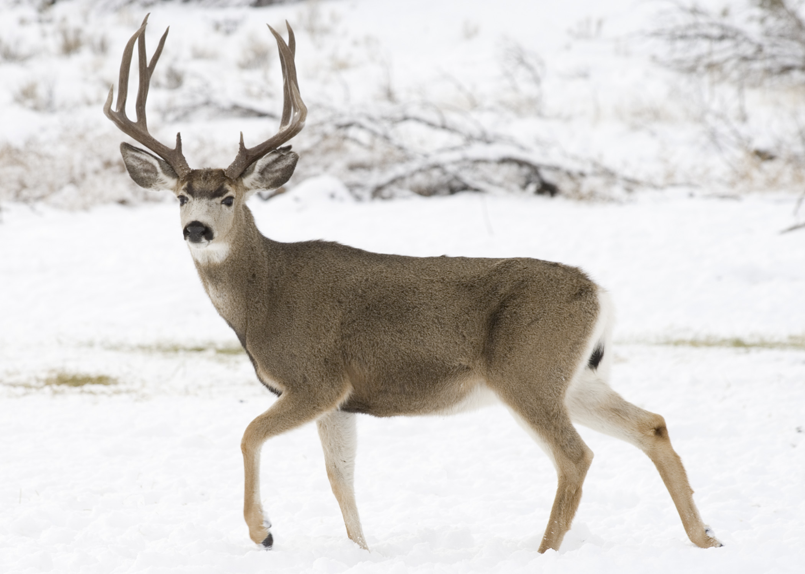
Notes:
Mule deer have bigger ears than white tail deer. Also, white tail deer have long white tails, and mule deer have a short white tails with a black tip on the end.

Slide 36
Mule Deer

Slide 37
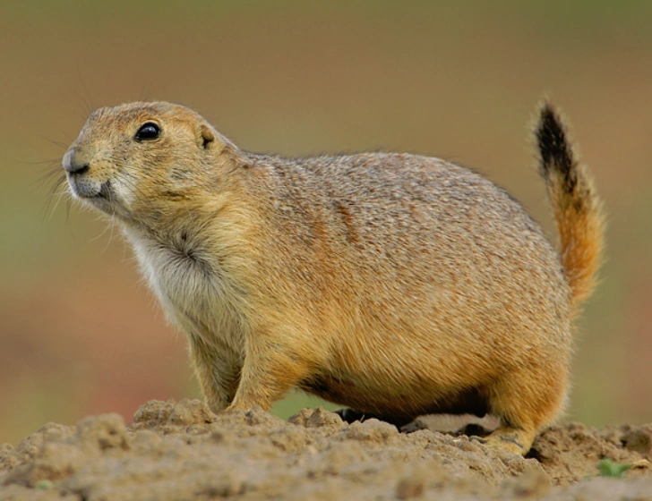

Slide 38
Black-Tailed Prairie Dog

Slide 39
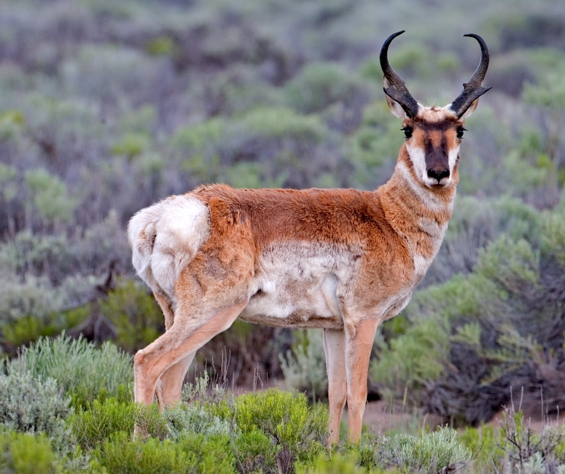

Slide 40
Pronghorn

Slide 41
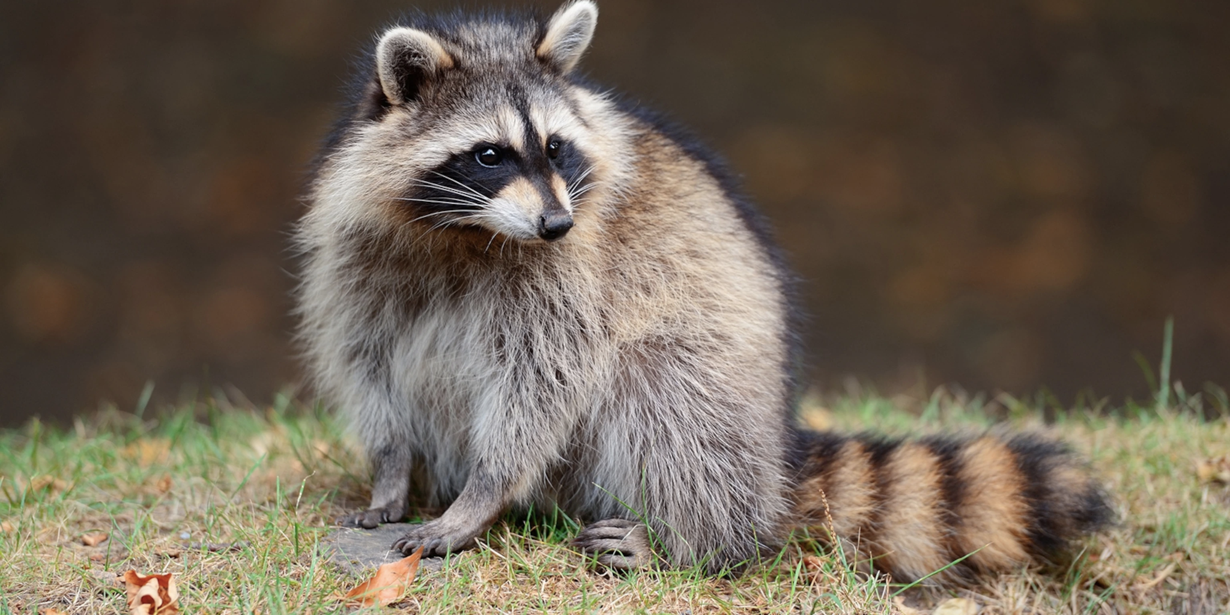

Slide 42
Raccoon

Slide 43
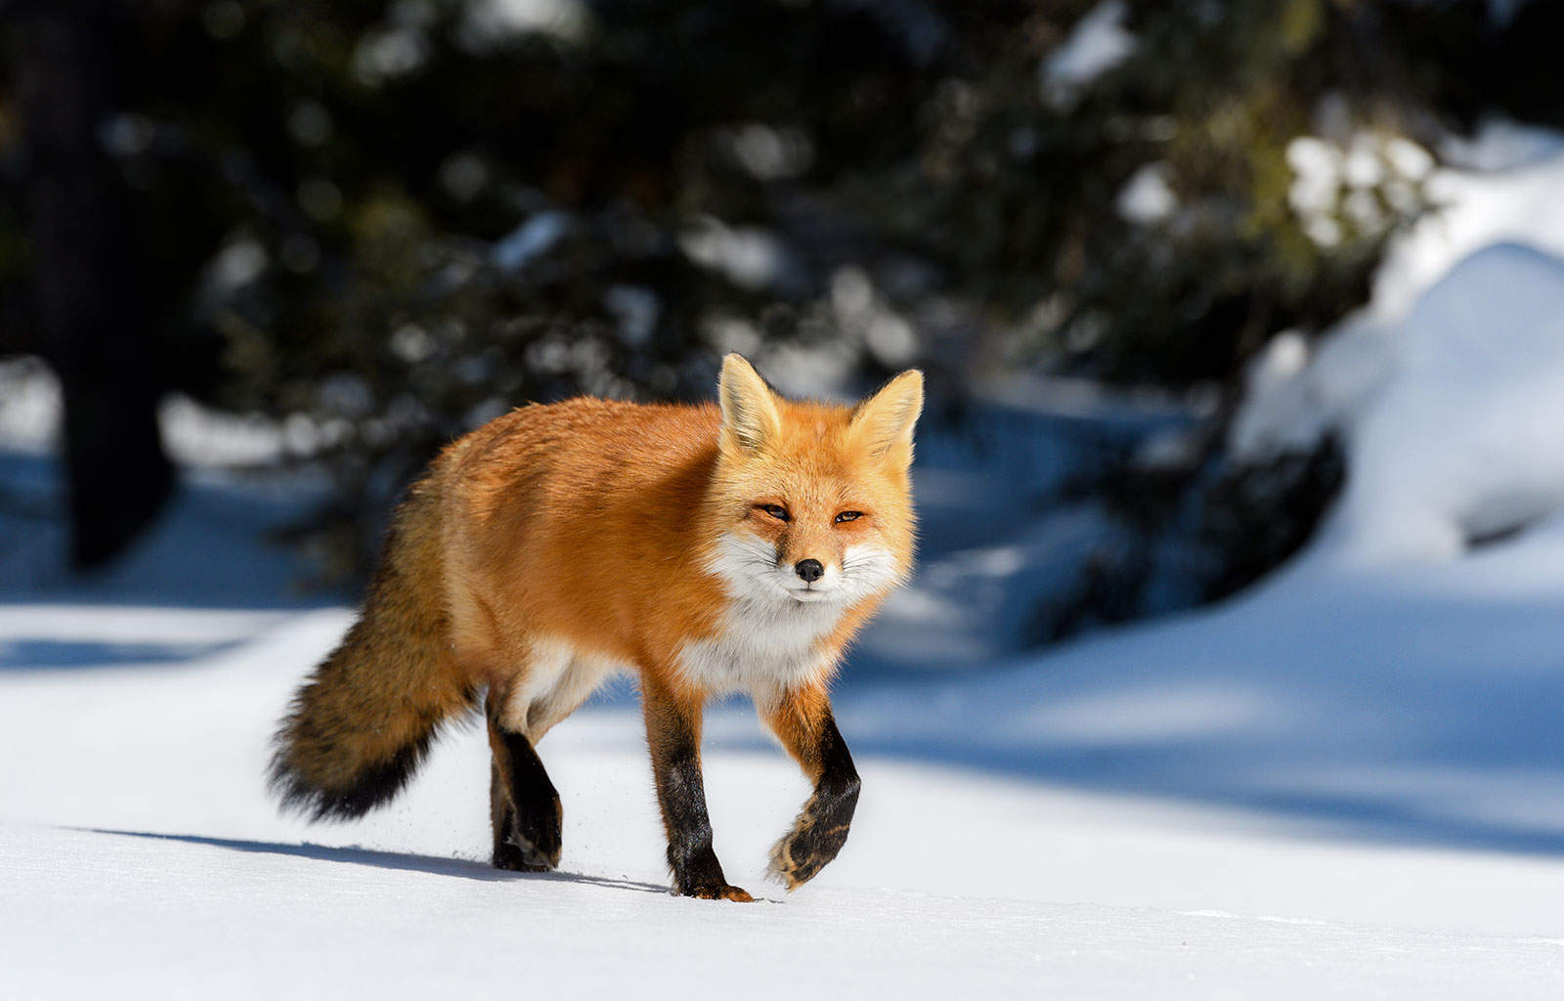

Slide 44
Red Fox

Slide 45
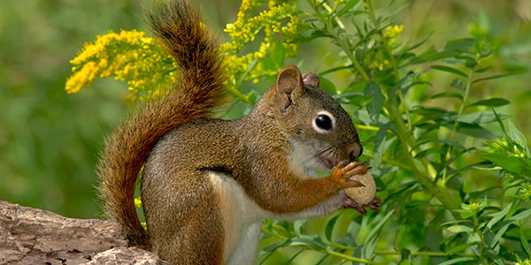

Slide 46
American Red Squirrel

Slide 47
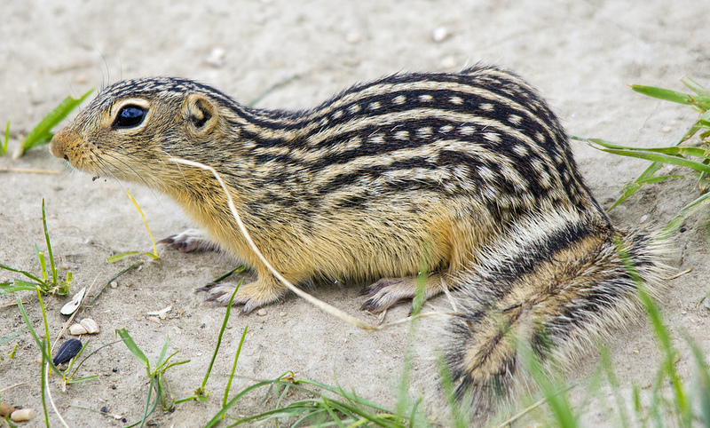

Slide 48
Thirteen-lined ground squirrel

Slide 49
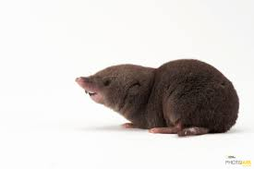

Slide 50
Northern Short-tailed Shrew

Slide 51
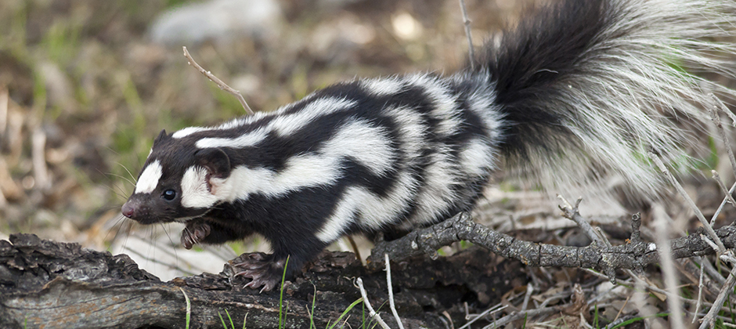

Slide 52
Eastern Spotted Skunk

Slide 53
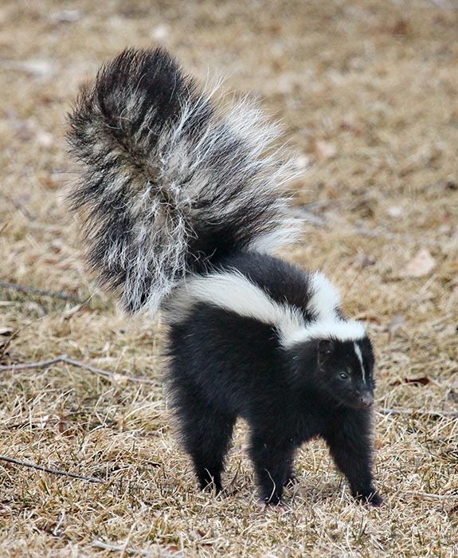

Slide 54
Striped Skunk

Slide 55
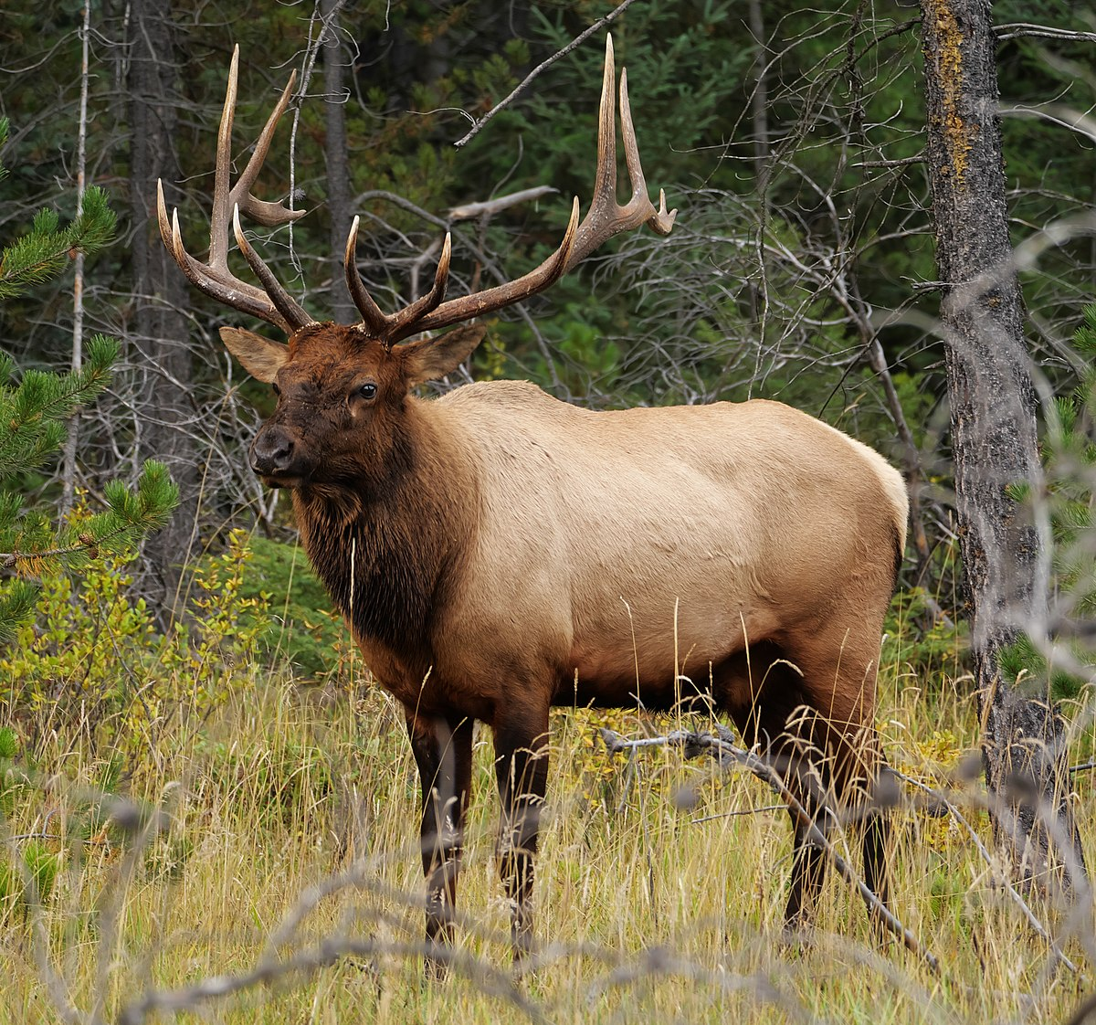

Slide 56
Elk

Slide 57
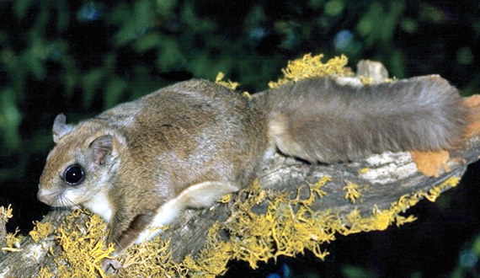

Slide 58
Northern Flying Squirrel

Slide 59
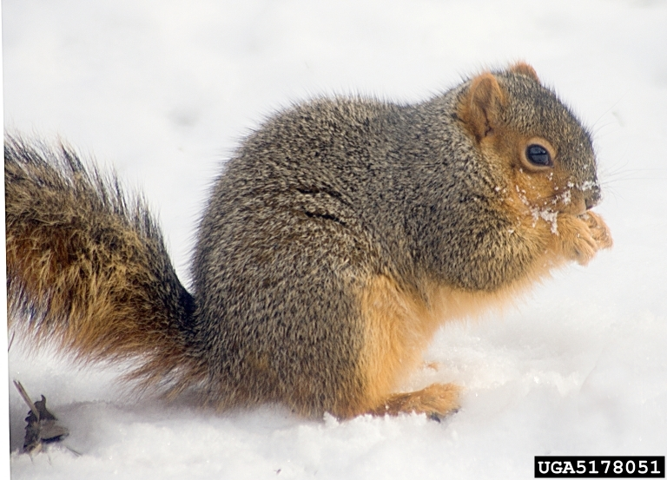

Slide 60
Fox Squirrel

Slide 61
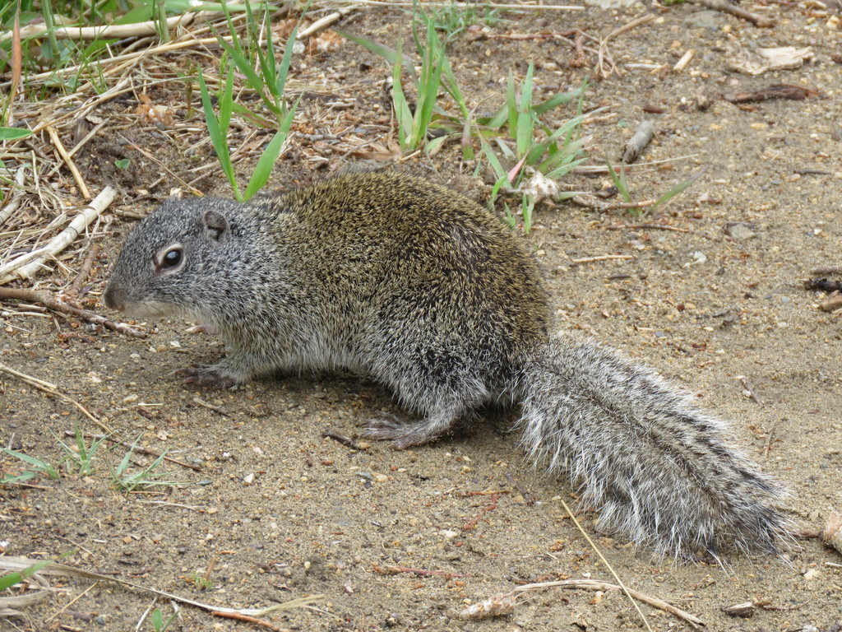

Slide 62
Franklin’s Ground Squirrel

Slide 63
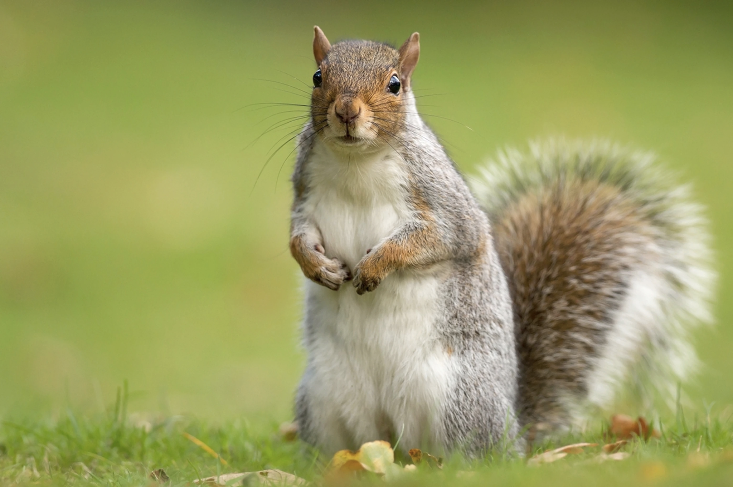

Slide 64
Eastern Gray Squirrel

Slide 65
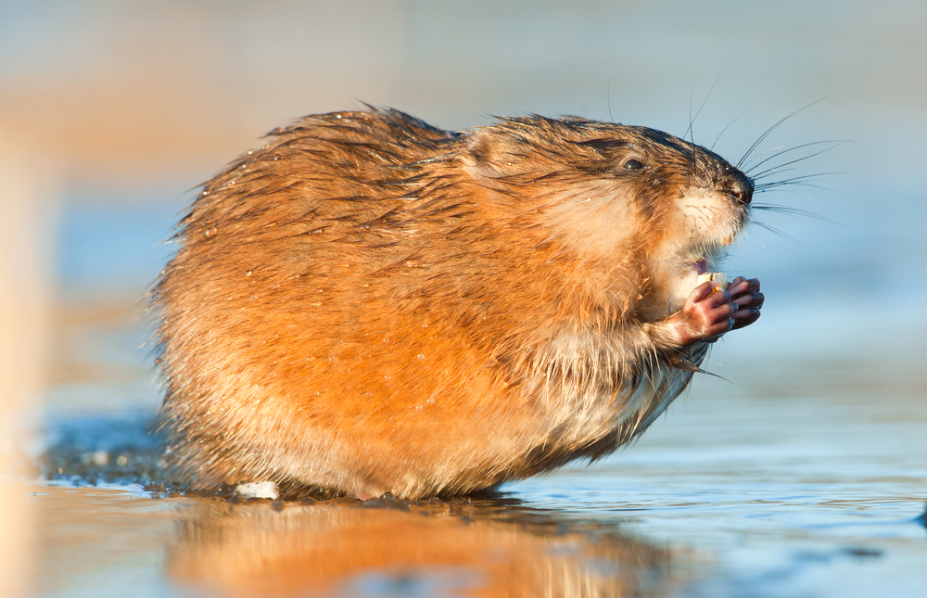

Slide 66
Muskrat

Slide 67
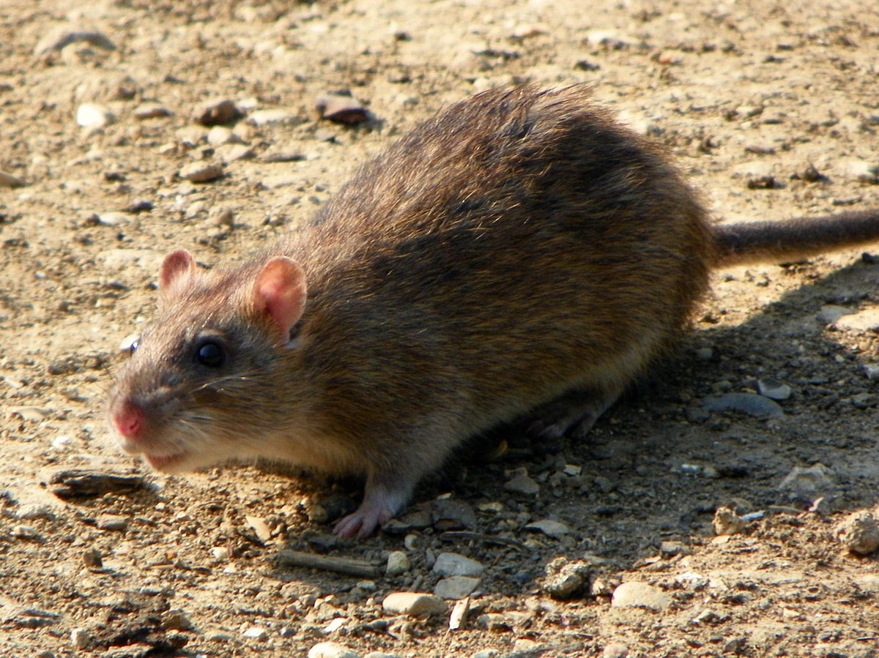

Slide 68
Brown Rat

Slide 69
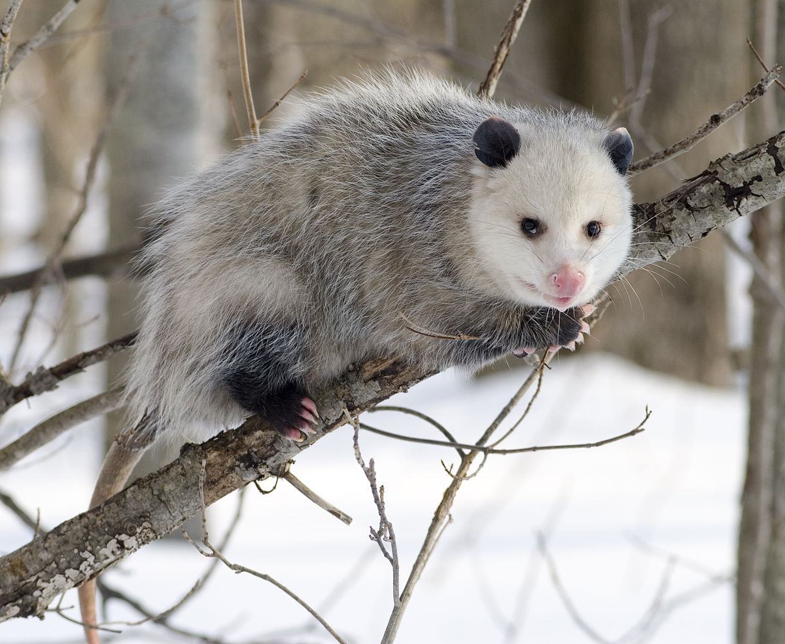

Slide 70
Virginia Opossum

Slide 71
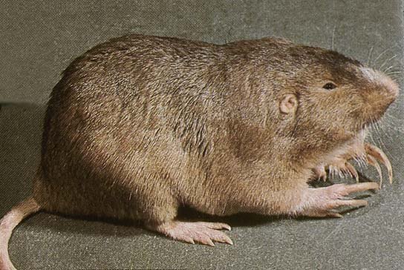

Slide 72
Plains Pocket Gopher

Slide 73
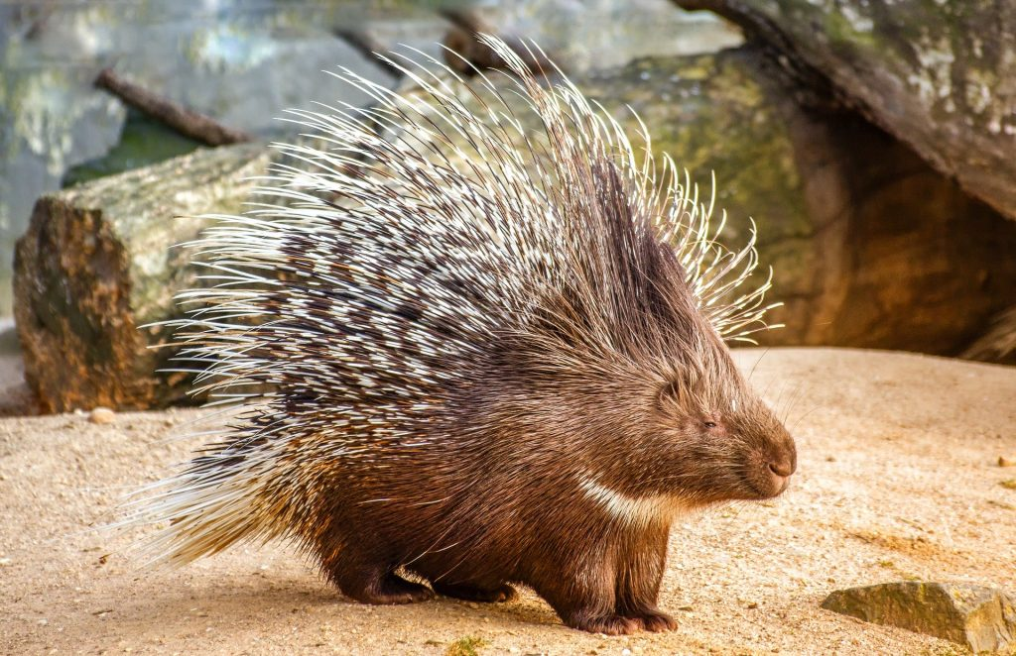

Slide 74
Porcupine

Slide 75
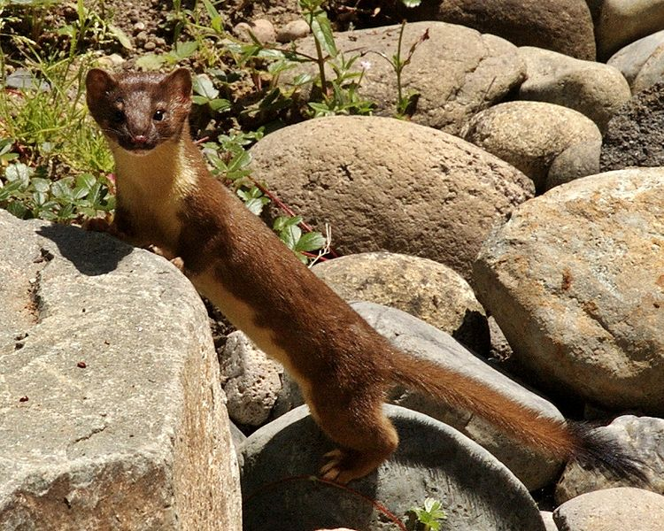

Slide 76
Long-tailed Weasel

Slide 77
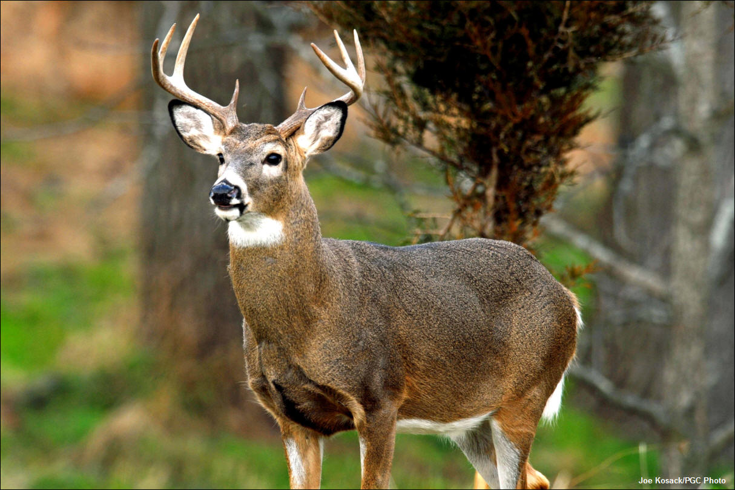

Slide 78
Whitetail Deer

Slide 79
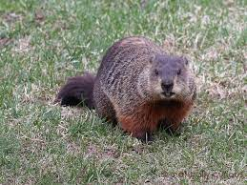

Slide 80
Woodchuck

