Slide 1
Natural Resources CDE
Insects

Slide 2
Aphid

Slide 3
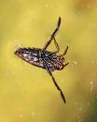
Back Swimmer

Slide 4
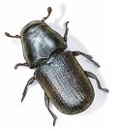
Mountain Pine Beetle

Slide 5
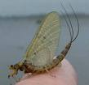
Mayfly

Slide 6
Bush Katydid

Slide 7
Carrion Beetle

Slide 8
Carpenter Ant

Slide 9
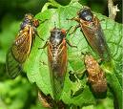
Cicada

Slide 10
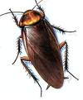
Cockroach

Slide 11
Skimmer Dragonfly

Slide 12
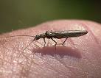
Stone Fly

Slide 13
Deer Fly

Slide 14
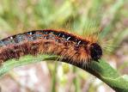
Eastern Tent Caterpillar

Slide 15
Field Cricket

Slide 16
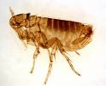
Flea

Slide 17
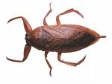
Giant Water Bug

Slide 18
Green Lacewing

Slide 19
Ground Beetle

Slide 20
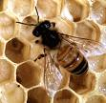
Honey Bee

Slide 21
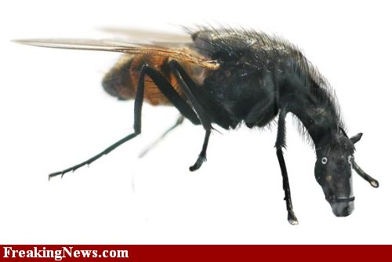
Horse Fly

Slide 22
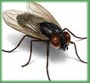
House Fly

Slide 23
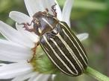
June Beetle

Slide 24
Ladybird Beetle

Slide 25
Leafhopper

Slide 26
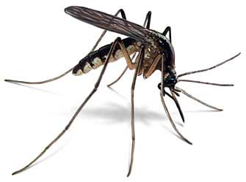
Mosquito

Slide 27
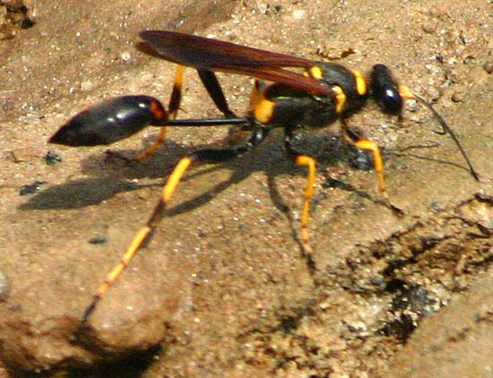
Mud-Dauber Wasp

Slide 28
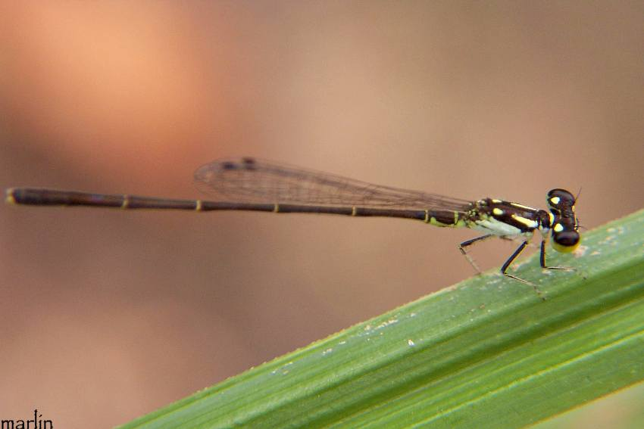
Narrow-winged Damsel Fly

Slide 29
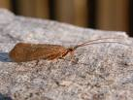
Northern Caddis Fly

Slide 30
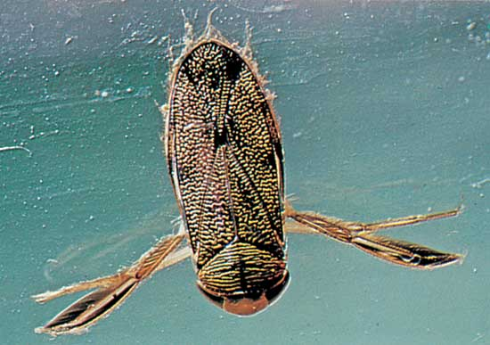
Water Boatman

Slide 31
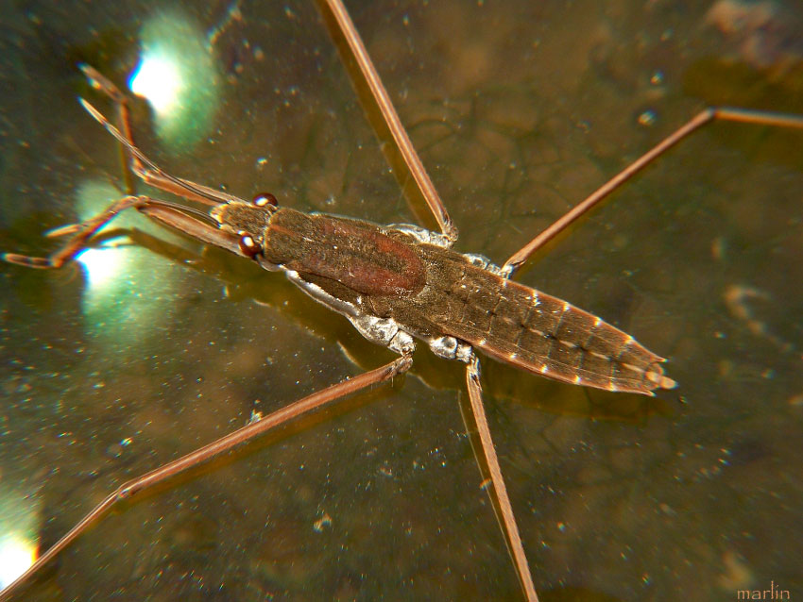
Water Strider

Slide 32
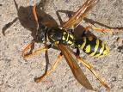
Yellow Jacket

Slide 33
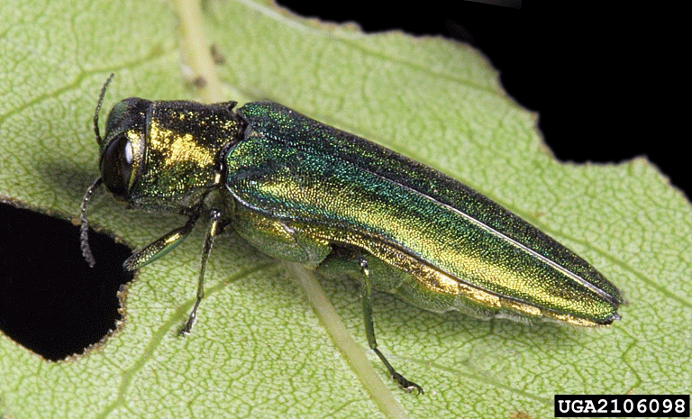
Emerald Ash Borer

Slide 34
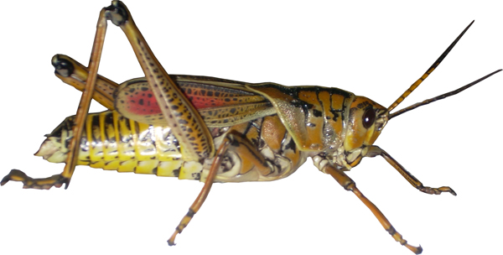
Grasshopper

Slide 35
The End

