Slide 1
Nursery/Landscape CDE
Equipment and Supply List
Updated 2023

Slide 2
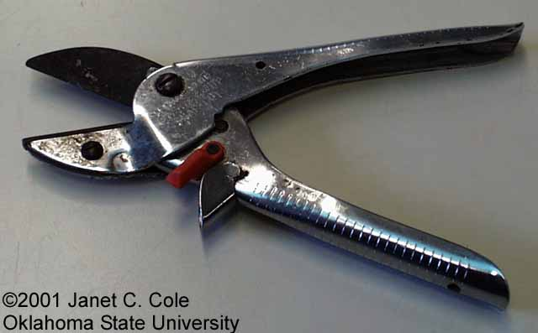
Anvil-and-blade Pruner

Slide 3

Ball Cart (B&B truck)

Slide 4
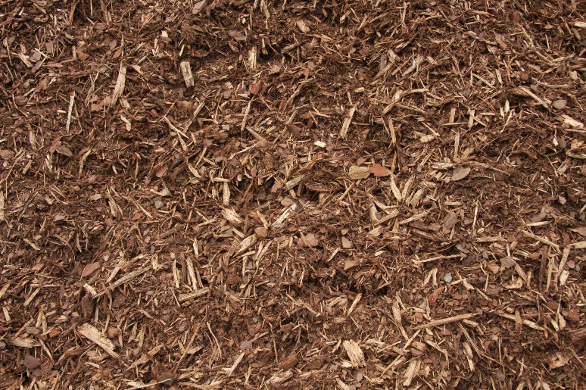
Bark Mulch

Slide 5
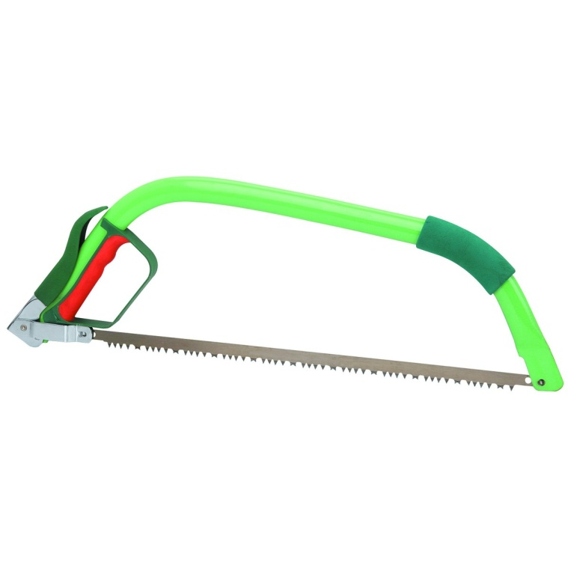
Bow Saw

Slide 6
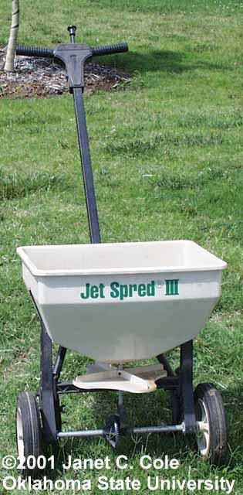
Broadcast (cyclone) Spreader

Slide 7
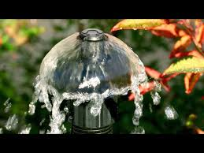
Bubbler head, irrigation

Slide 8
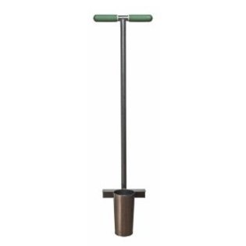
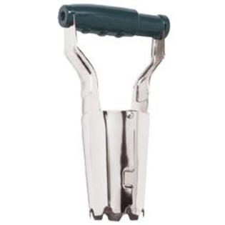
Bulb Planter

Slide 9
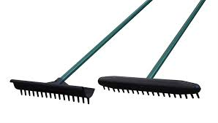
Bunker Rake

Slide 10

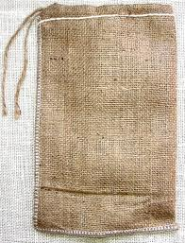
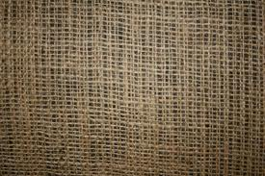
Burlap

Slide 11
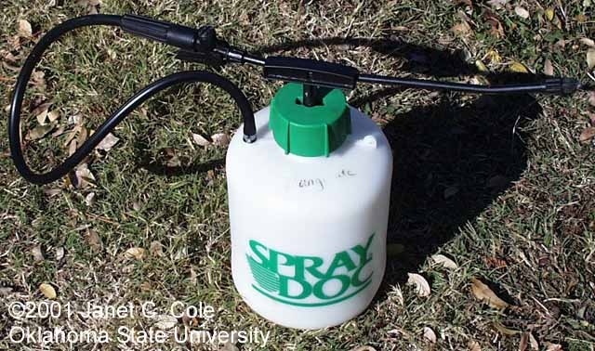
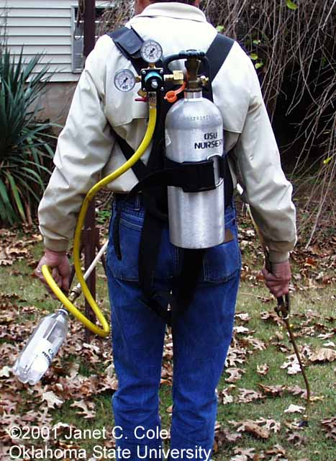
Compressed Air Sprayer

Slide 12
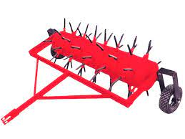
Core Aerifier

Slide 13
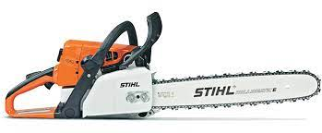
Chain Saw

Slide 14
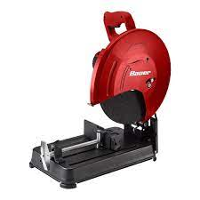
Cut-off Machine

Slide 15
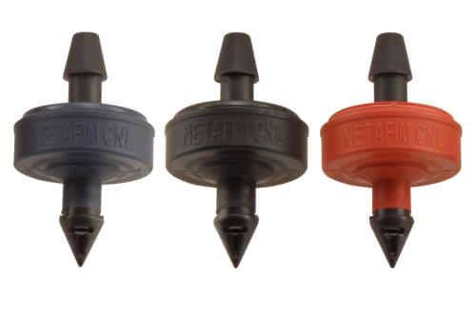
Drip emitter, irrigation

Slide 16
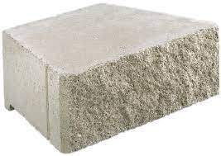

Slide 17
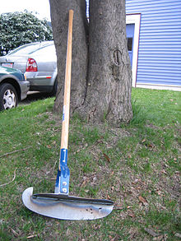
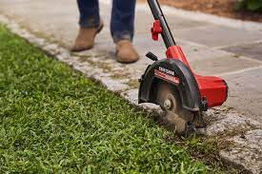
Edger

Slide 18
Edging

Slide 19
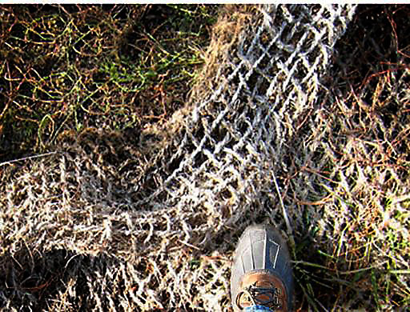
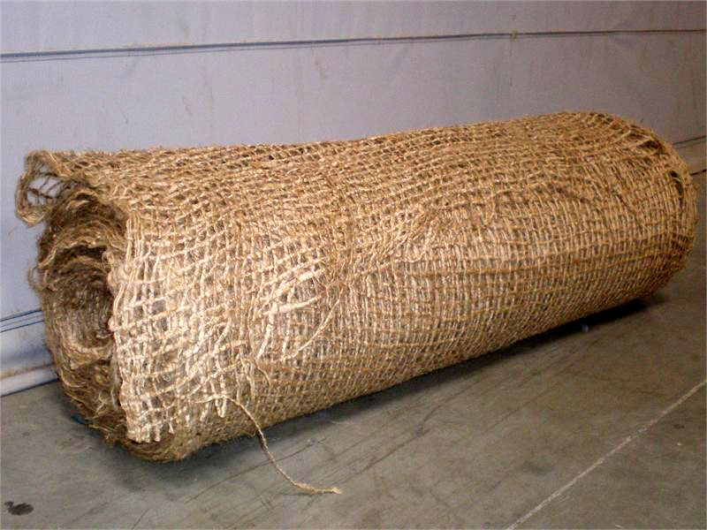
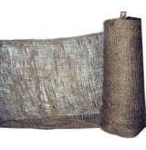
Erosion Netting

Slide 20
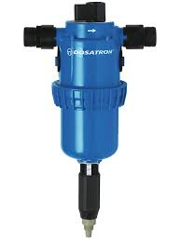
Fertilizer Injector

Slide 21
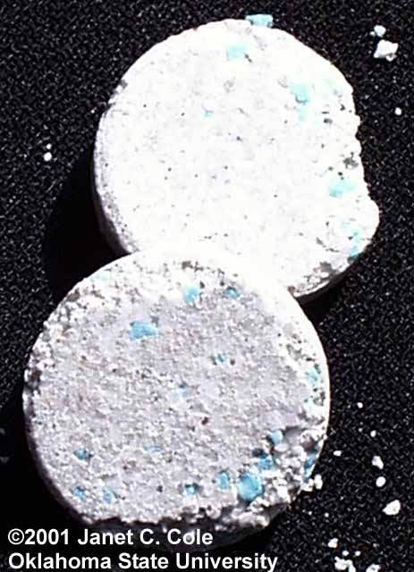
Fertilizer Tablet

Slide 22
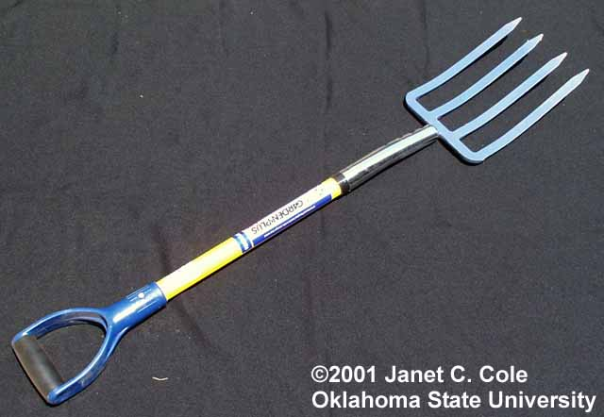
Garden Fork

Slide 23
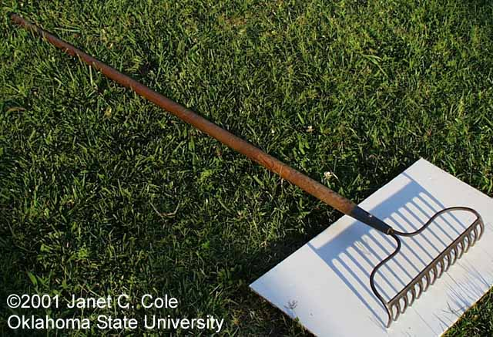
Garden Rake

Slide 24
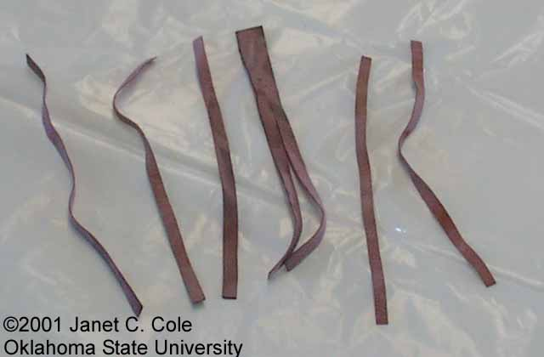
Grafting Band

Slide 25
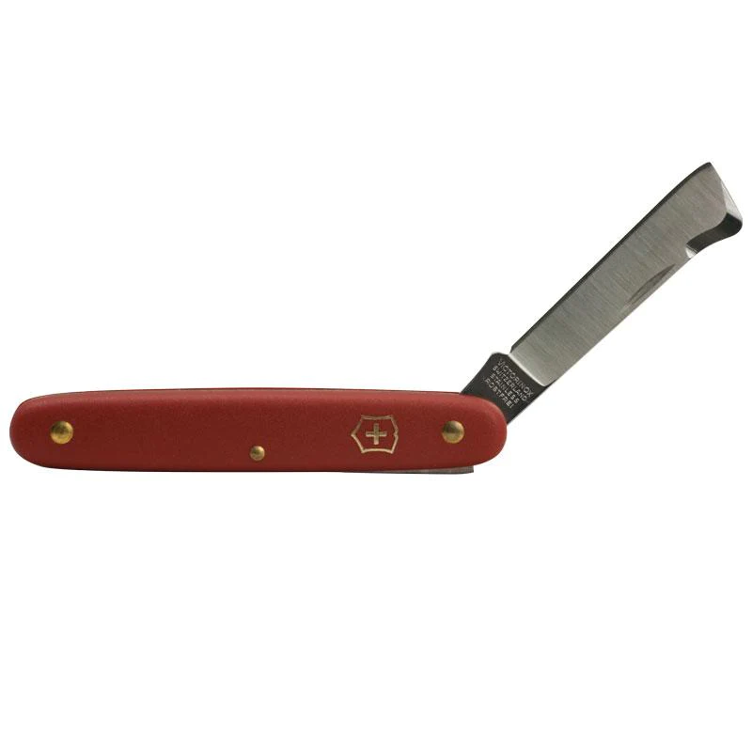
Grafting Knife

Slide 26

Granular Fertilizer

Slide 27
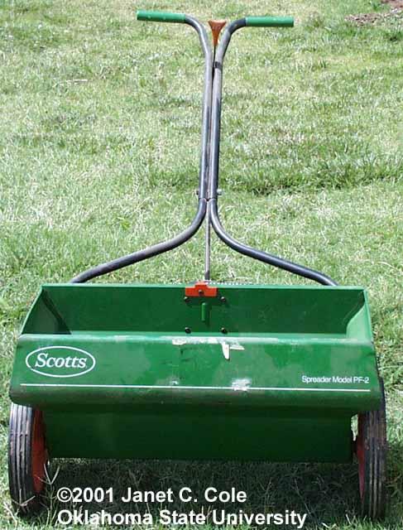
Gravity (drop) Spreader

Slide 28
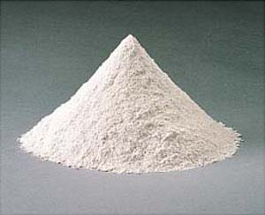
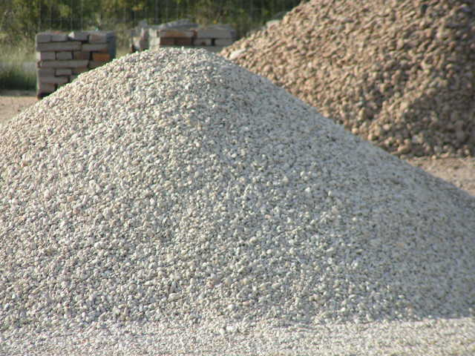
Ground Limestone

Slide 29
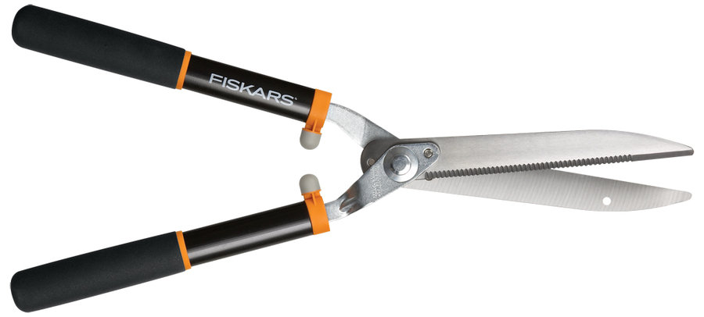
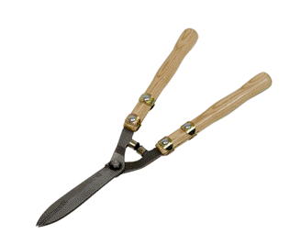
Hedge Shears

Slide 30
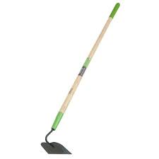
Hoe

Slide 31
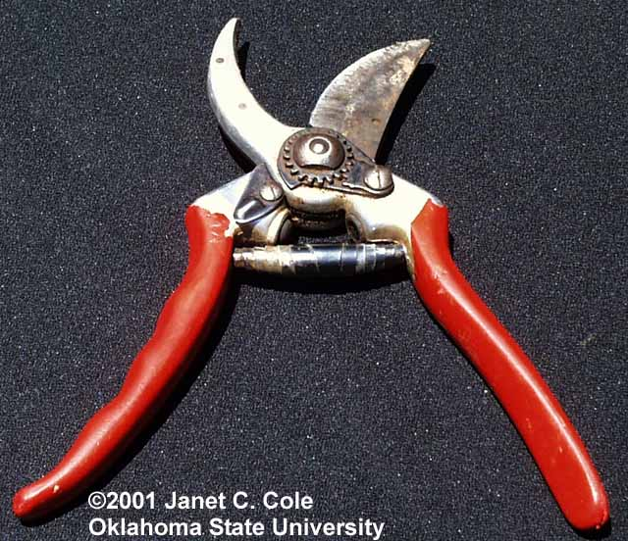
Hook-and-blade Pruners

Slide 32
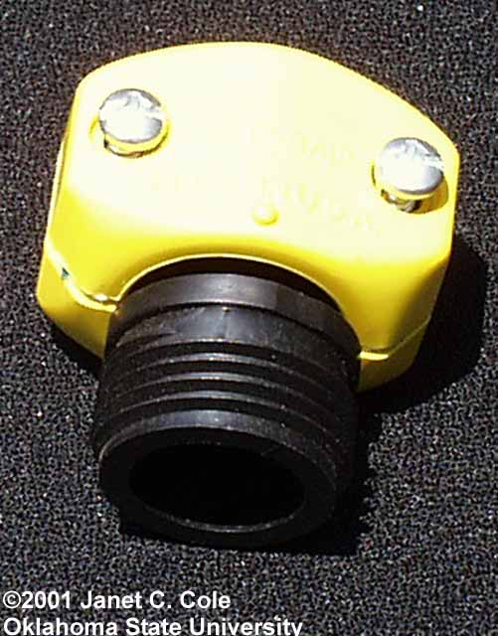
Hose-end Repair Fitting

Slide 33
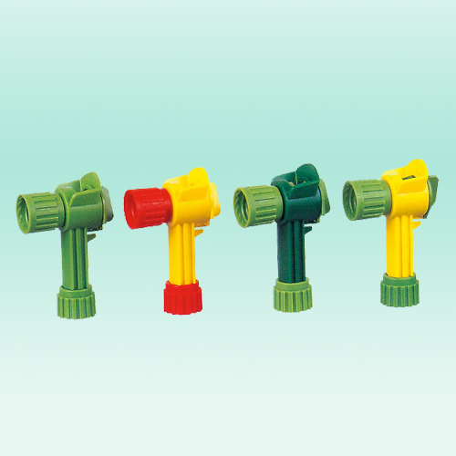
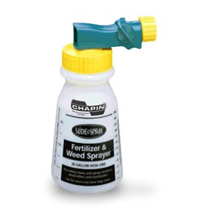
Hose-end Sprayer

Slide 34
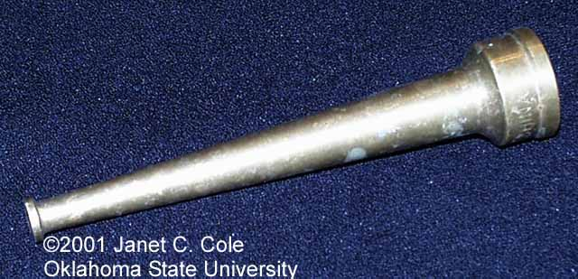
Hose-end Washer

Slide 35
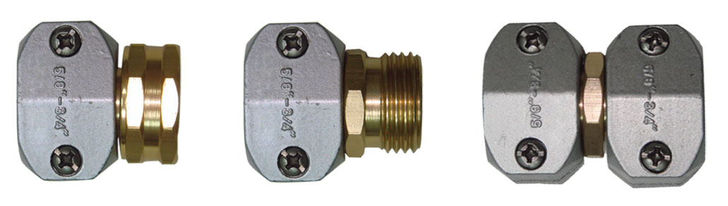
Hose Repair Coupling

Slide 36
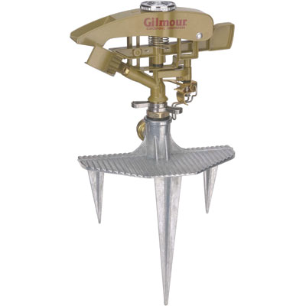
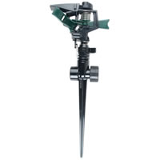
Impulse Sprinkler

Slide 37
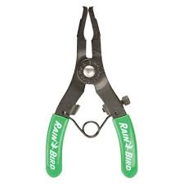
Irrigation Ring Tool

Slide 38
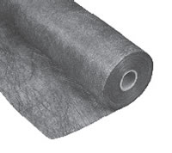
Landscape Fabric (mulch)

Slide 39
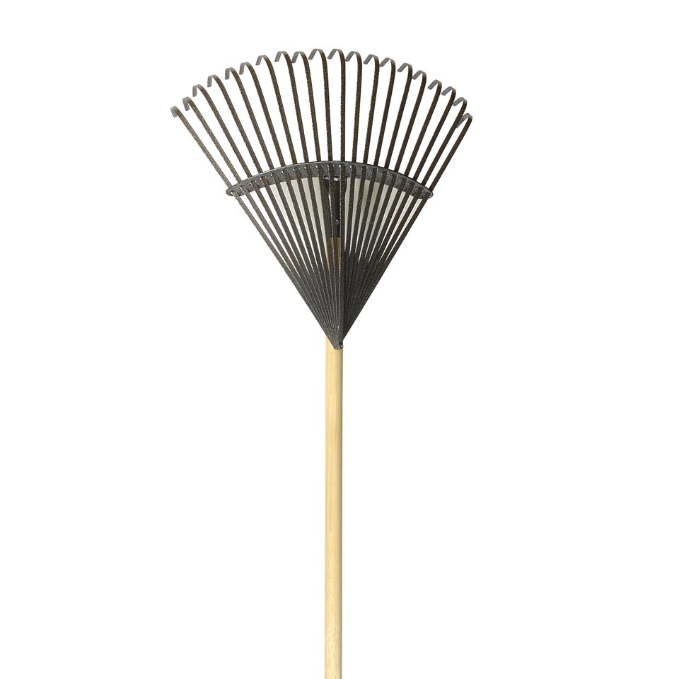
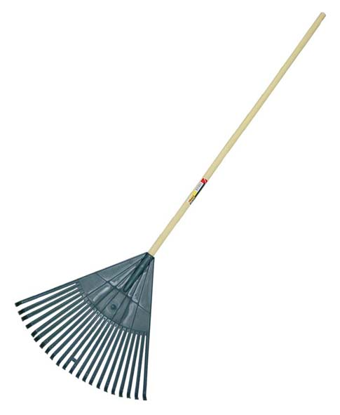
Leaf Rake

Slide 40
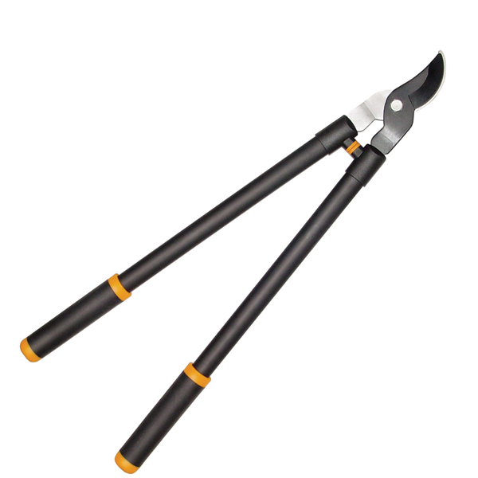
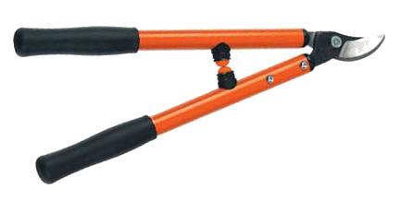
Loppers

Slide 41
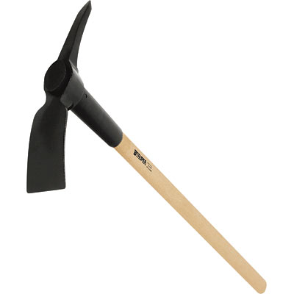
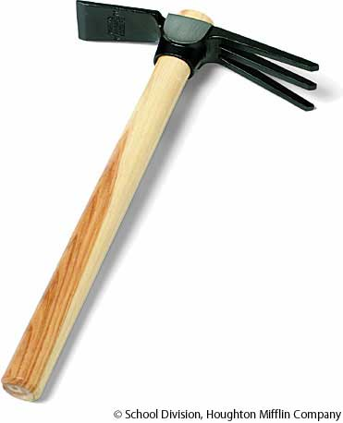
Mattock

Slide 42

Measuring Wheel

Slide 43


Mist Nozzle (mist bed)

Slide 44

Mower Blade Balancer

Slide 45

Nursery Container

Slide 46

Oscillating Sprinkler

Slide 47

Peat Moss

Slide 48


Pick Axe

Slide 49

Planting/Earth/Soil Auger

Slide 50



Pole Pruner

Slide 51


Polyethylene Pipe

Slide 52

Pop-up irrigation head

Slide 53

Post-hole digger

Slide 54



Power Blower

Slide 55

Power Hedge Trimmer

Slide 56

Pot-in-pot unit

Slide 57

Pump Sprayer

Slide 58

Propagation mat

Slide 59


Pruning Saw

Slide 60

Quick Coupler

Slide 61

Quick Coupler Head Adapter

Slide 62

Reel Mower

Slide 63

Resin-coated Fertilizer

Slide 64

Rotary Mower

Slide 65

Rototiller

Slide 66


Round Point Shovel

Slide 67


Scoop Shovel

Slide 68






Shade Fabric

Slide 69

Sharpening Stone

Slide 70

Siphon Proportioner

Slide 71


Soaker Hose

Slide 72

Soil Sampling Tube

Slide 73

Solenoid Valve

Slide 74

Spade

Slide 75



Sphagnum Moss

Slide 76

Square Point (flat) Shovel

Slide 77

String Trimmer

Slide 78

Thatch Rake

Slide 79

Tree Caliper

Slide 80

Tree Wrap

Slide 81

Trowel

Slide 82



Vertical Mower

Slide 83


Water Breaker

Slide 84

Wire tree Basket

