Slide 1
Bird Group 2

Slide 2
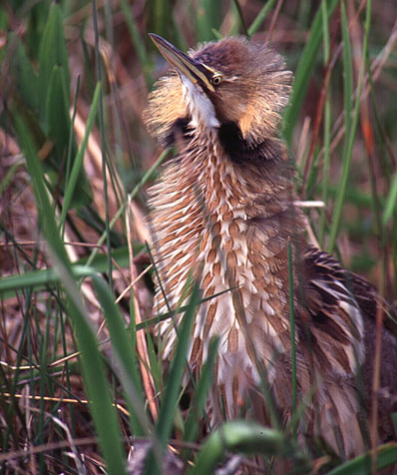
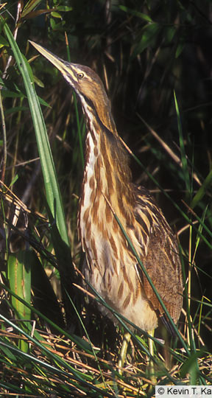
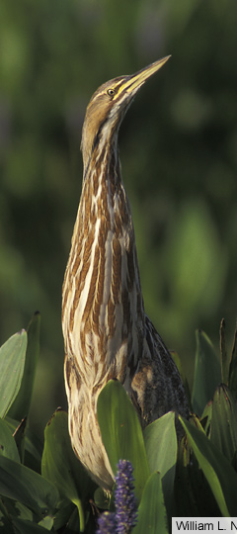
American Bittern

Slide 3
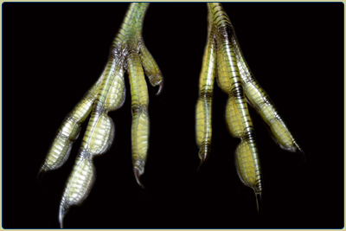
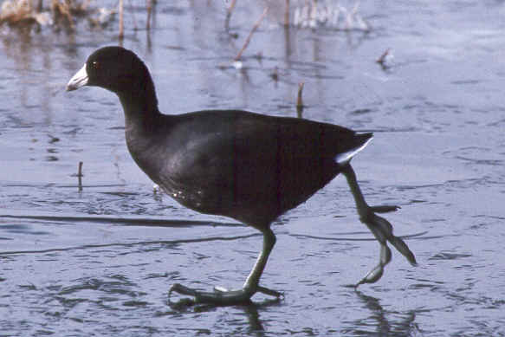
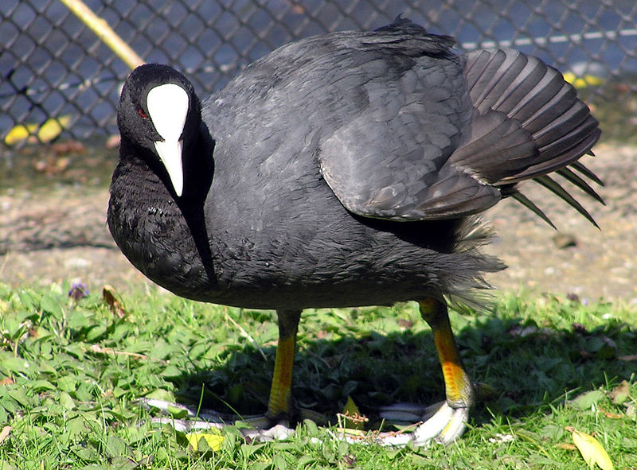
American Coot

Slide 4
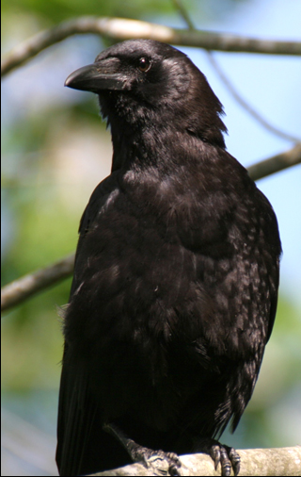
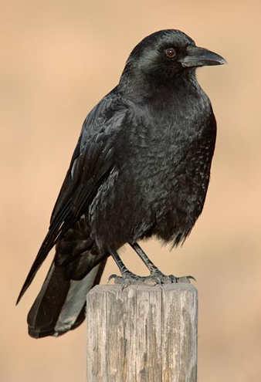
American Crow

Slide 5
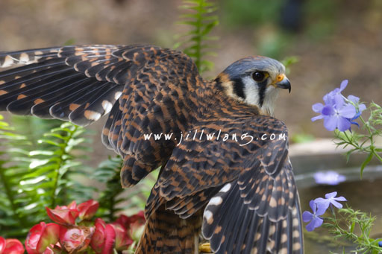
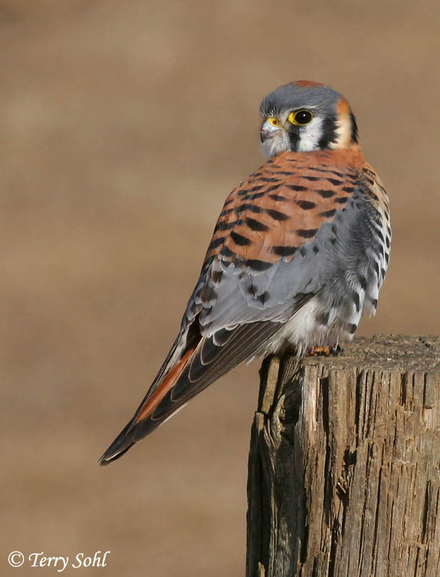
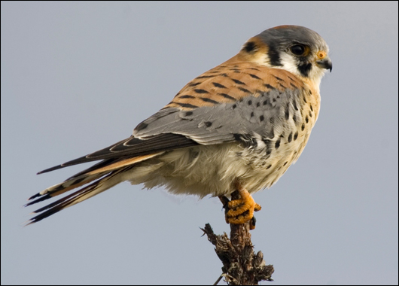
American Kestrel

Slide 6
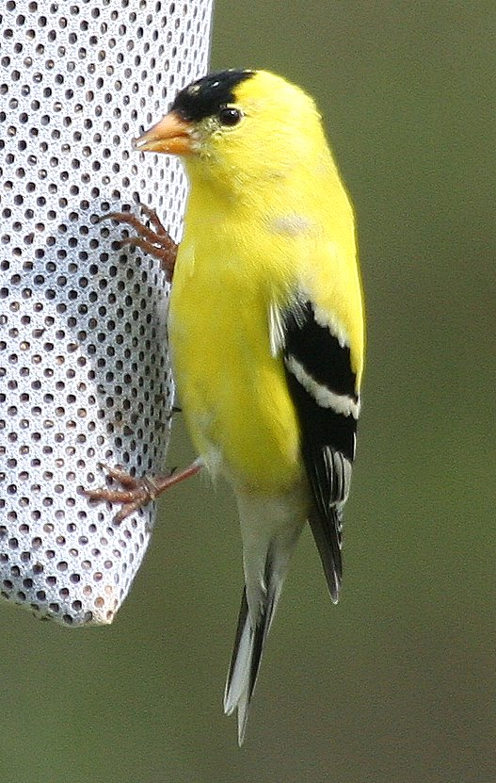
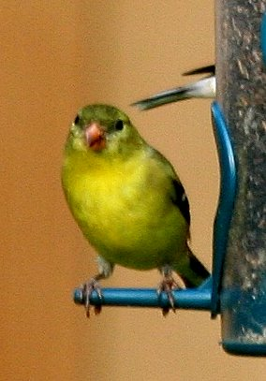
American Goldfinch

Slide 7
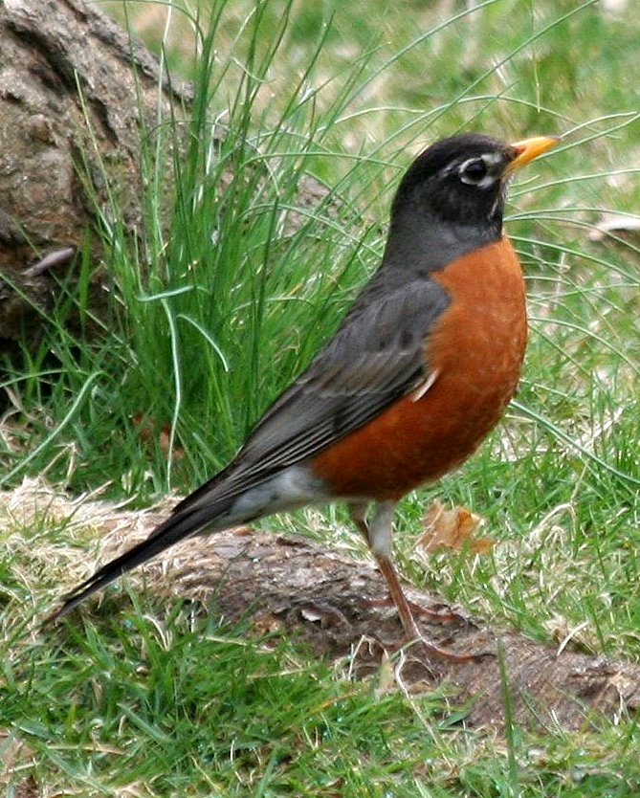
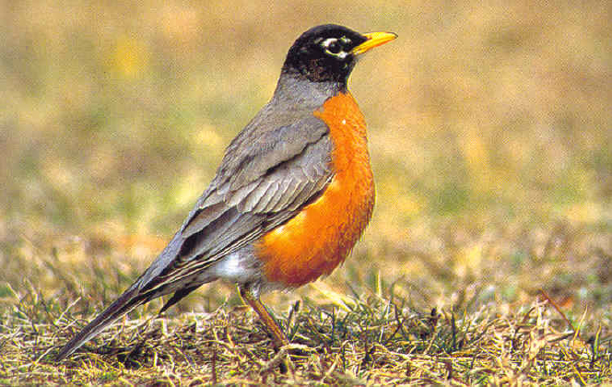
American Robin

Slide 8
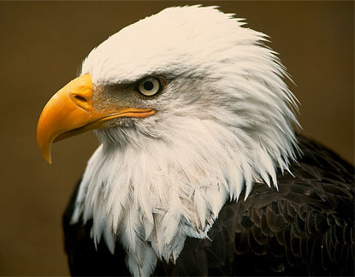
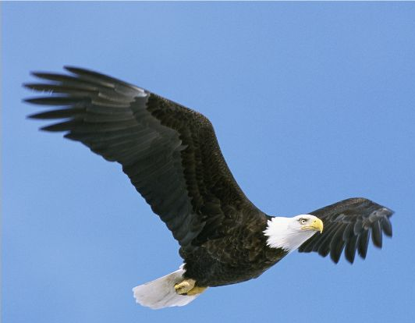
Bald Eagle

Slide 9
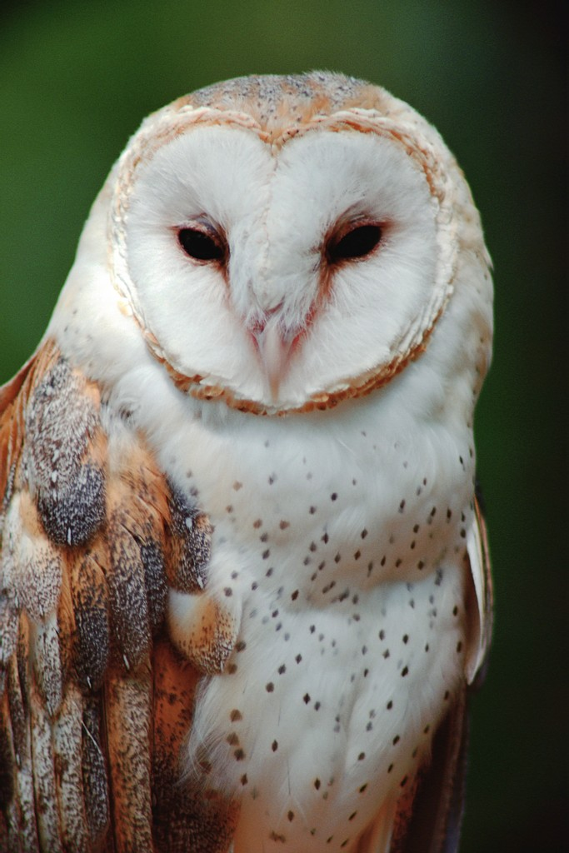
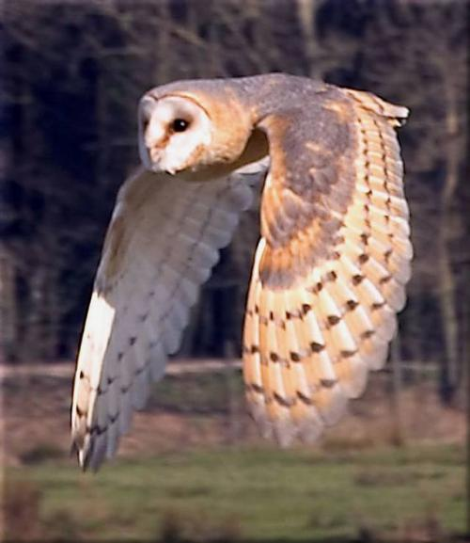
Barn Owl

Slide 10
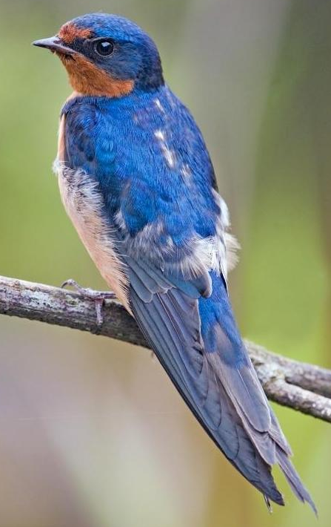
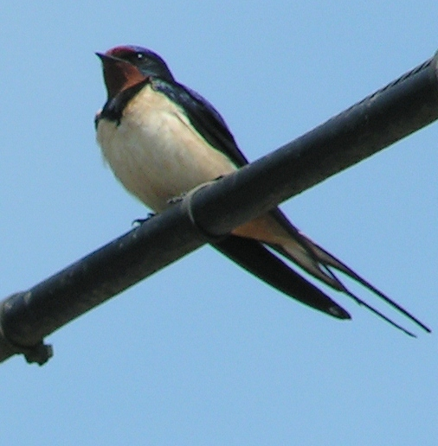
Barn Swallow

Slide 11
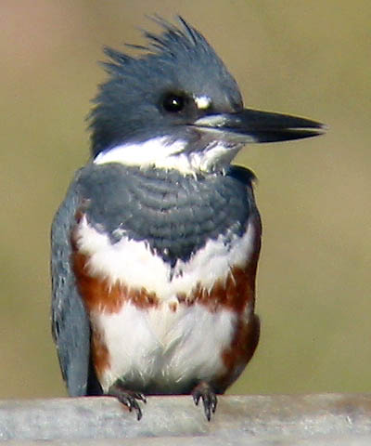
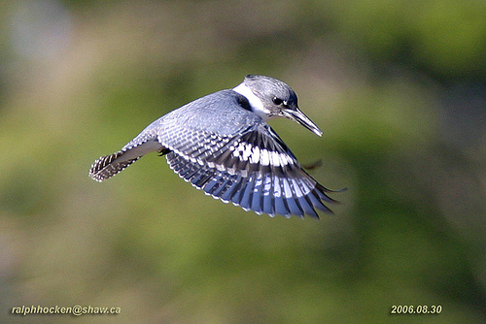
Belted Kingfisher

Slide 12
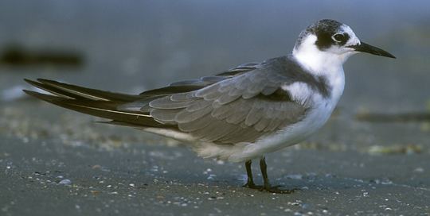
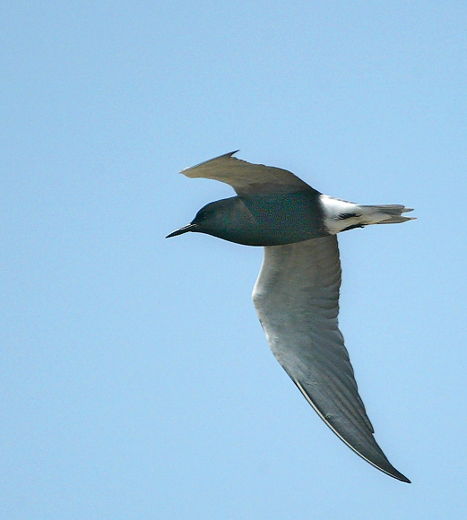
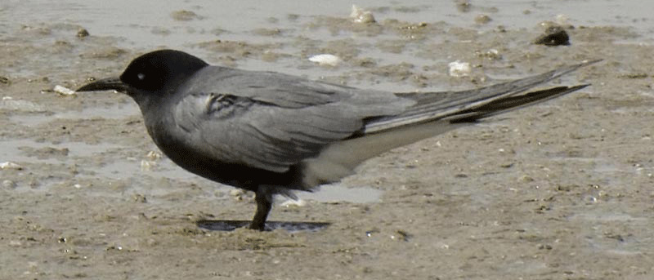
Black Tern
Nonbreeding
Breeding

Slide 13
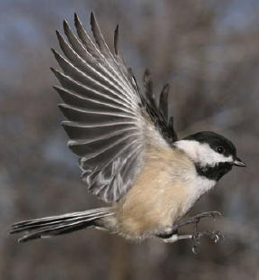
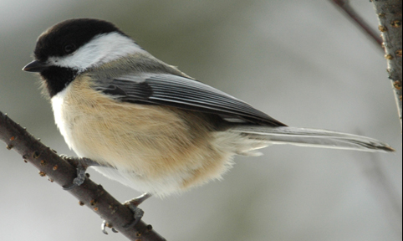
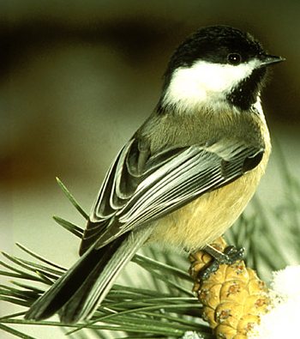
Black-capped Chickadee

Slide 14
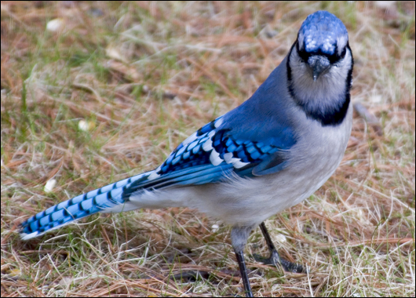
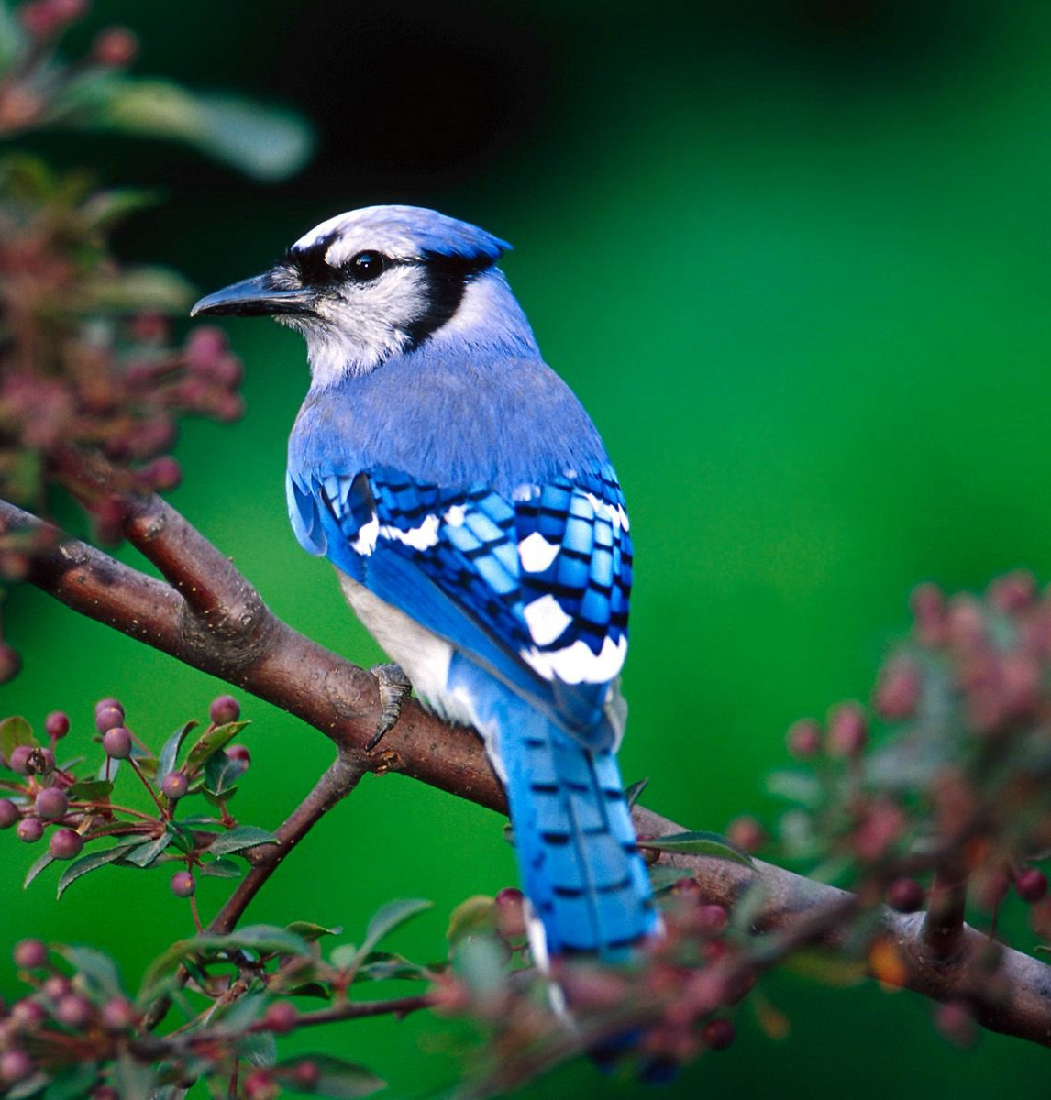
Blue Jay

Slide 15
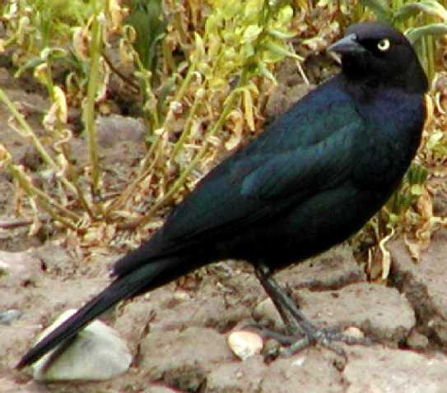
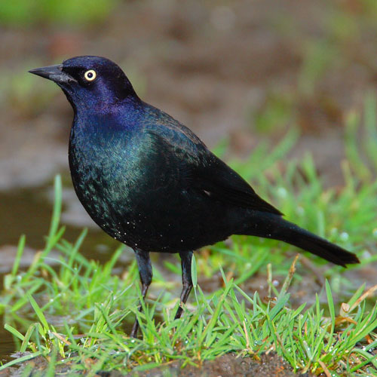
Brewers Blackbird

Slide 16
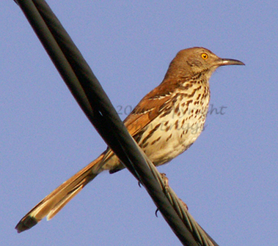
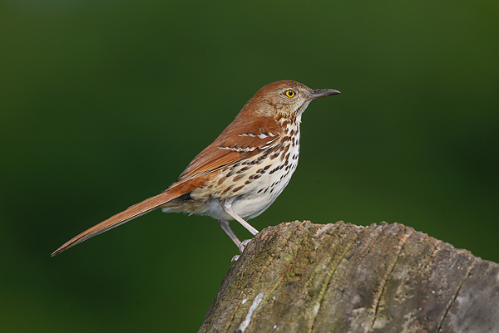
Brown Thrasher

Slide 17
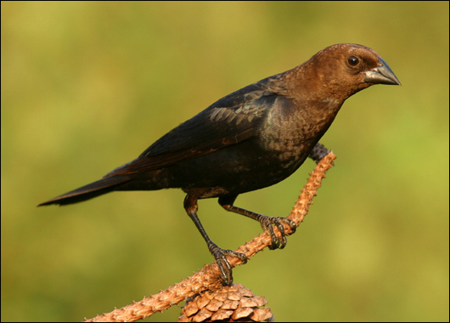
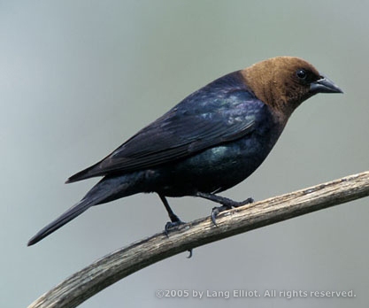
Brown-Headed Cowbird

Slide 18
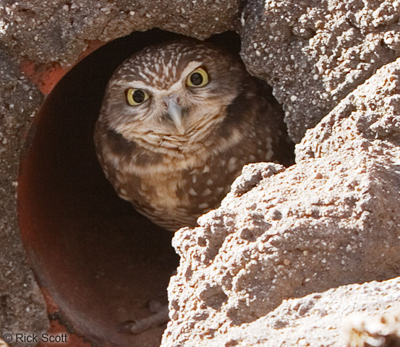
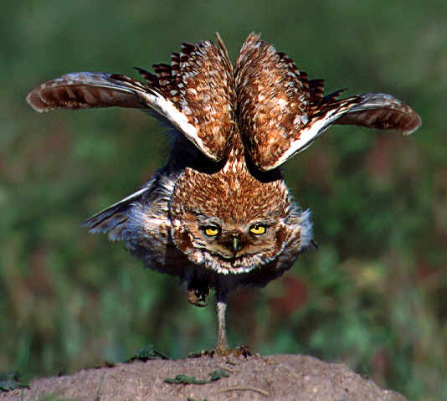
Burrowing Owl

Slide 19
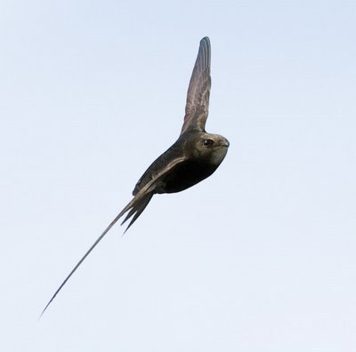
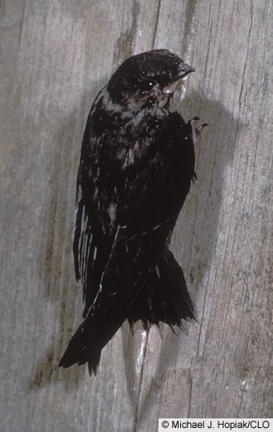
Chimney Swift

Slide 20
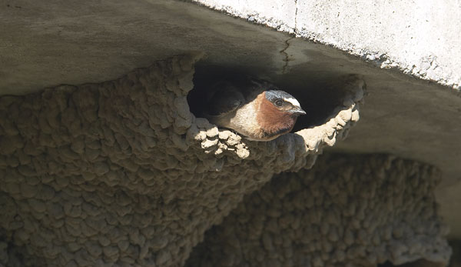
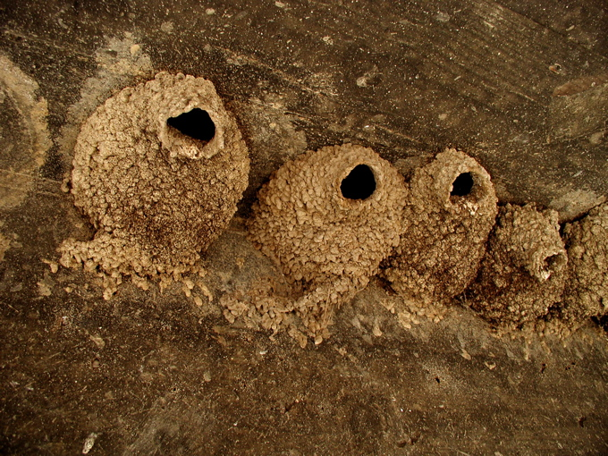
Cliff Swallow

Slide 21
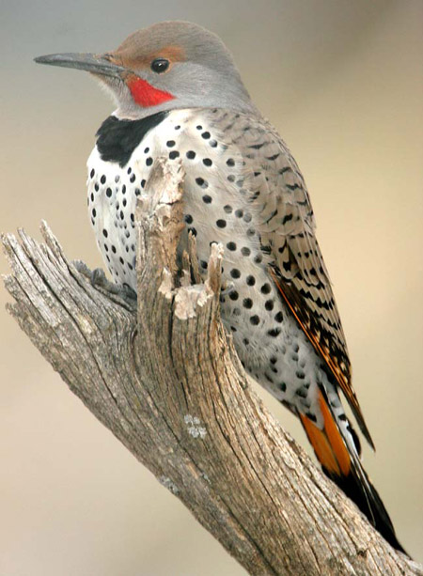
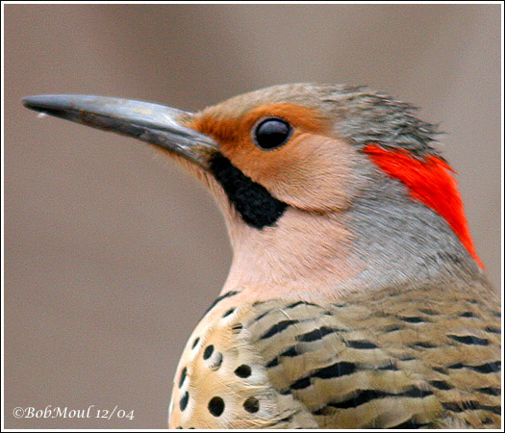
Common Flicker

Slide 22
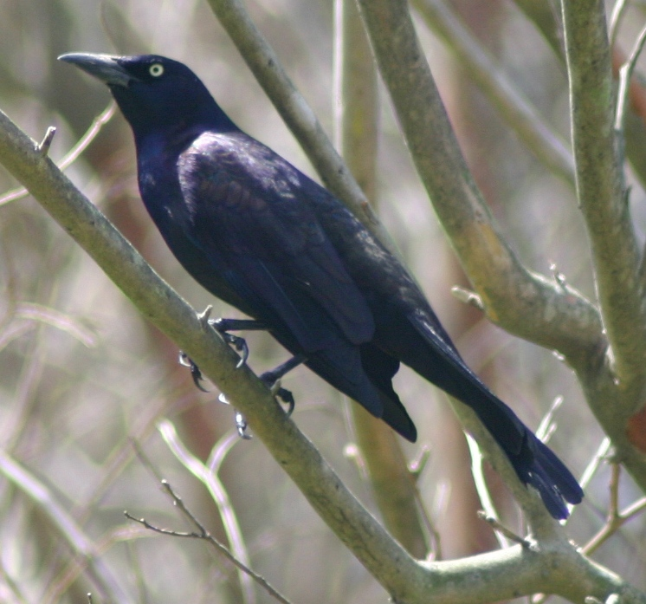
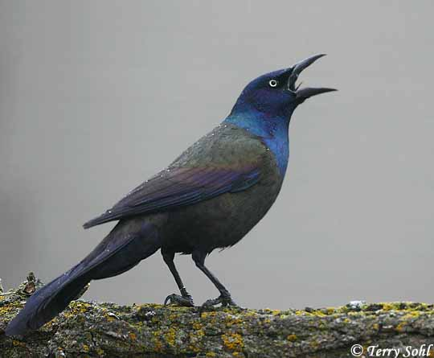
Common Grackle

Slide 23
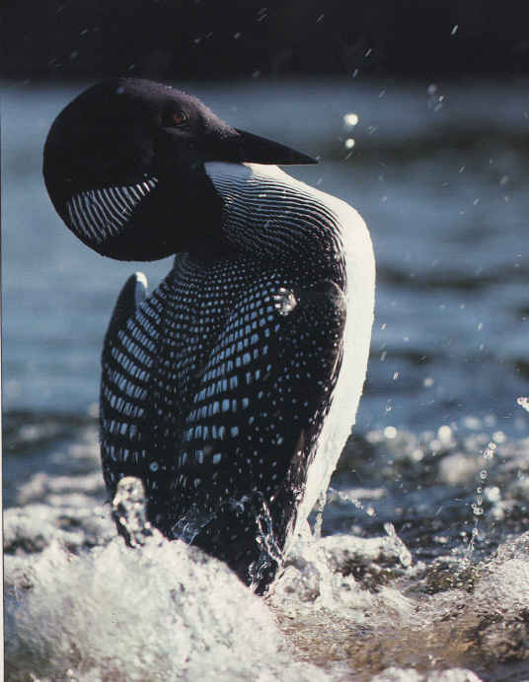
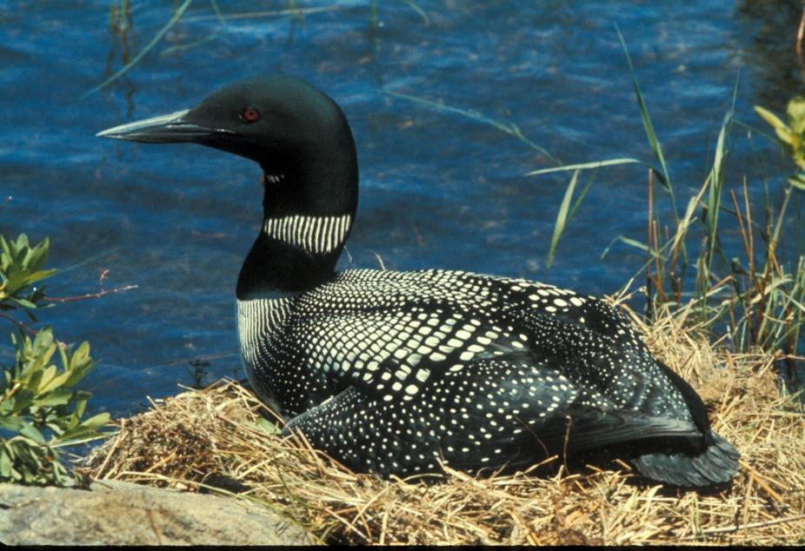
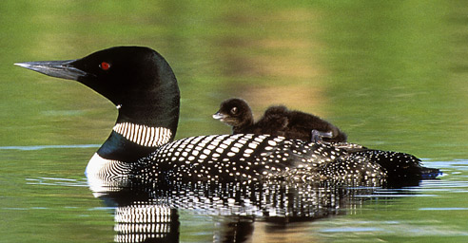
Common Loon

Slide 24
Common Nighthawk

Slide 25
Common Redpoll

Slide 26
Common Snipe

Slide 27
Common Tern
Nonbreeding

Slide 28
Cooper’s Hawk

Slide 29
Dark-Eyed Junko

Slide 30
Double Crested Cormorant

Slide 31
Dowitcher (long or short billed)

Slide 32
Downy Woodpecker

Slide 33
Eastern Kingbird

Slide 34
European Starling

Slide 35
Eurasian Collard Dove

Slide 36
Ferruginous Hawk

Slide 37
Franklin’s Gull
Breeding
Nonbreeding

Slide 38
Golden Eagle

Slide 39
Great Blue Heron
White morph

Slide 40
Great Egret

Slide 41
Great Horned Owl

Slide 42
Horned Lark

Slide 43
House Finch

Slide 44
House Sparrow

Slide 45
House Wren

Slide 46
Killdeer

Slide 47
Least Tern

Slide 48
Long-billed Curlew

Slide 49
Marbled Godwit

Slide 50
Northern Harrier

Slide 51
Oriole

Slide 52
Peregrine Falcon

Slide 53
Pine Siskin

Slide 54
Piping Plover

Slide 55
Purple Martin

Slide 56
Redheaded Woodpecker

Slide 57
Red-Tailed Hawk

Slide 58
Red-winged Blackbird

Slide 59
Ring-billed Gull
Nonbreeding
Breeding

Slide 60
Rough-legged Hawk

Slide 61
Ruby-throated Hummingbird

Slide 62
Screech Owl

Slide 63
Sharp-shinned Hawk

Slide 64
Short-eared Owl

Slide 65
Swainson’s Hawk

Slide 66
Tundra Swan

Slide 67
Upland Sandpiper

Slide 68
Western Meadowlark

Slide 69
White Pelican

Slide 70
White-Breasted Nuthatch

Slide 71
Willet

Slide 72
Wilson’s Phalarope

Slide 73
Yellow Warbler

Slide 74
Yellow-headed Blackbird

Slide 75
Greater/Lesser Yellowlegs

